Slide 1




Nano-Hz GW Astronomy: Its Promises
A. Gopakumar
TIFR, Mumbai, India
(KGWG-10, 08/27/2025)

Slide 2
Outline:
Pulsar Timing Arrays (&IPTA) for nHz GW astronomy
Possibility to pursue Persistent Multi-Messenger nHz GW Astronomy with sources mainly at cosmological distances!!!
Close Asian Collaboration will be critical

Slide 3
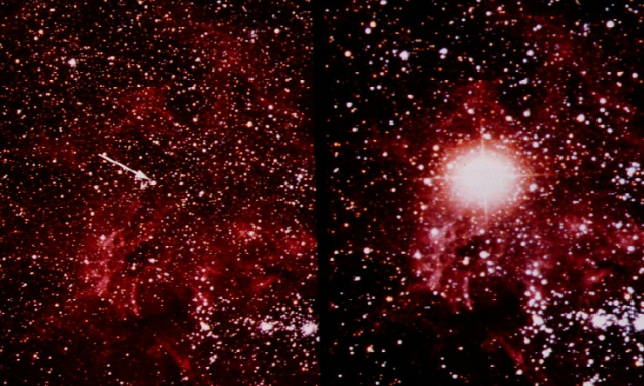
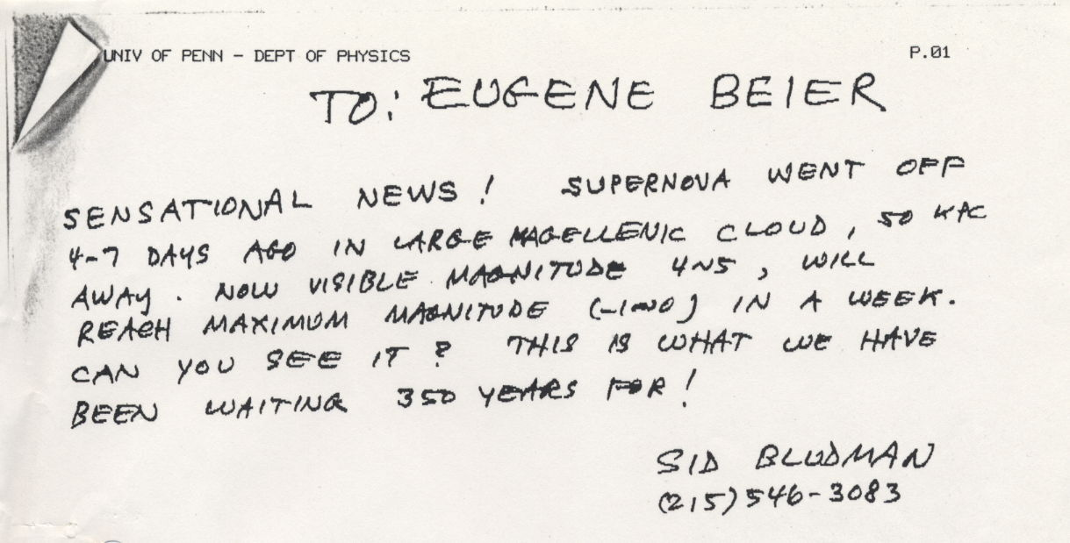
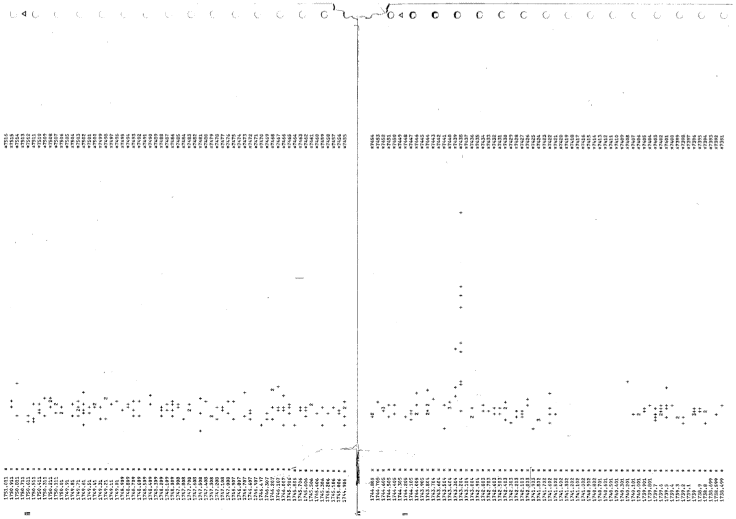
SN1987A : Human’s First Multi-Messenger Astronomy Event
Kunkel, W., Madore, B., Shelton, I., et al. 1987, iau circ, 4316
Difference in the TOA of 38 Mev & 22 MeV 𝛎s ~ 5 seconds (after traveling ~ 50Kpc )
( 11 neutrinos after 16:35:35 on February 23, 1987).

Slide 4

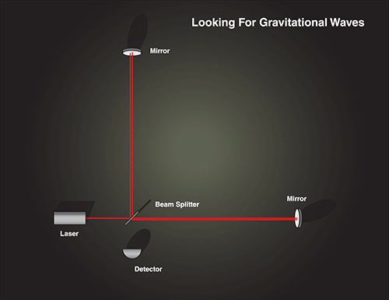
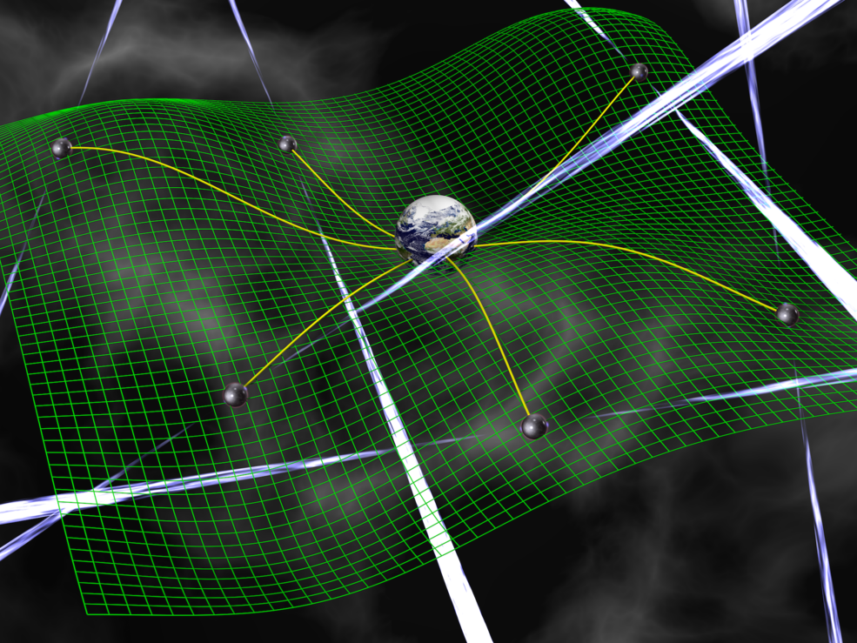
Gravitational Waves: Dark Messengers!
►GWs are tidal interactions that propagate with the speed of light
GWs cause changes in the travel time of light between two free particles

Slide 5
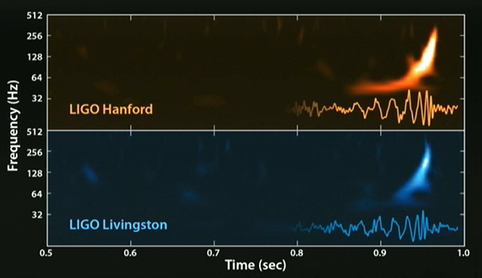
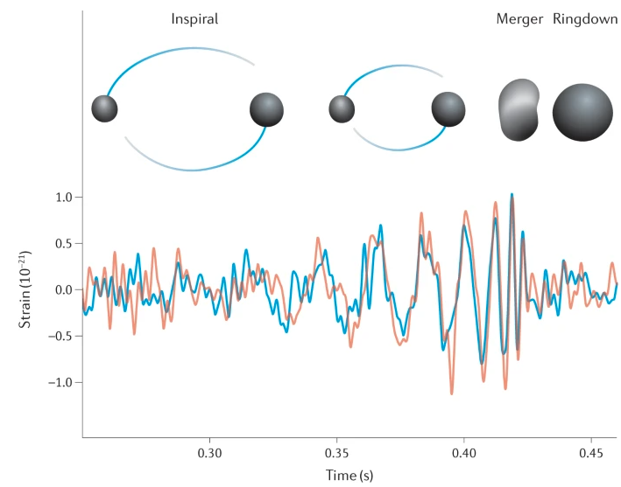
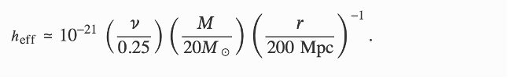

Era of hecto-hertz GW Astronomy: LVK’s GW150914 (arXiv:1602.03838)
Merger of ~30 & 35 Solar Mass BHs at ~ 400 Mpc
→ A new branch of Astronomy !!
Notes:
https://www.nature.com/articles/s42254-021-00303-8 ( Fig 1)
LVK collaboration detected 100 GWs events from merging stellar-mass BH-BH. NS-NS and BH-NS binaries. What we see in the figure is the two merging BH inspiralling around each other and afterward they merge. At last, they form the ringdown state. The IMR template has been shown in the figure.

Slide 6
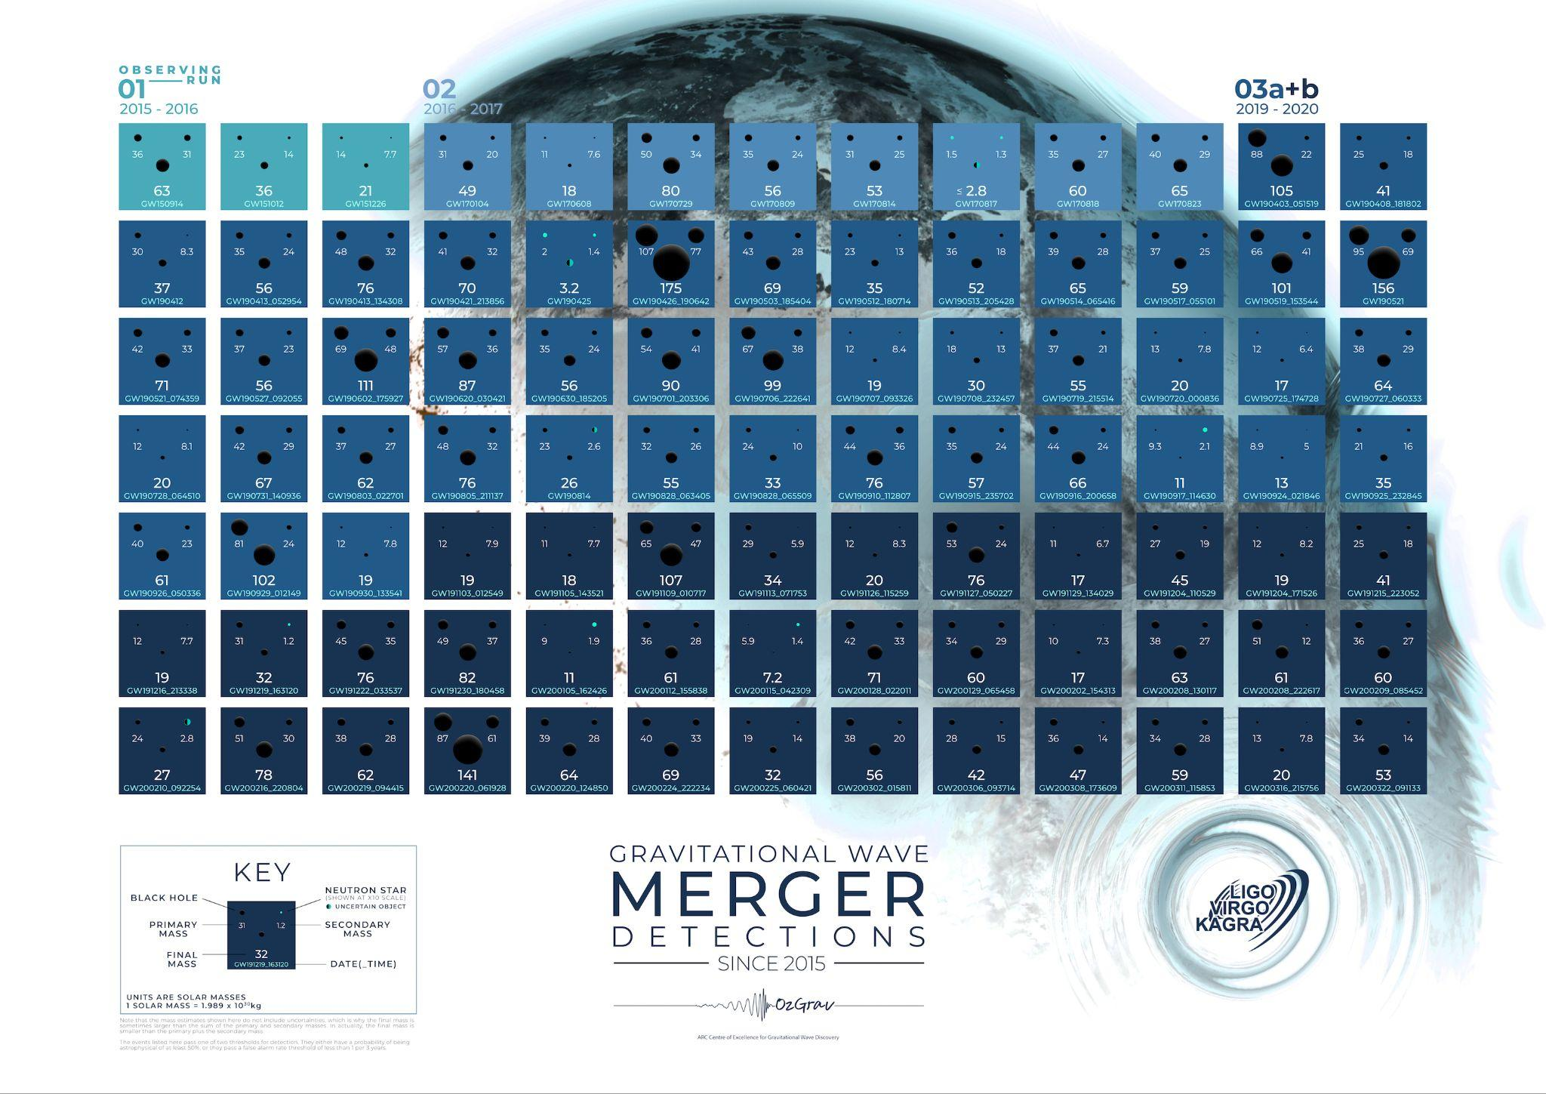
Era of hecto-hertz GW Astronomy: II
LVK collaboration has detected >150 transient GW events from merging stellar mass BH -BH , NS-NS and BH-NS binaries during the last 8 years in 4 observational runs
Notes:
https://www.nature.com/articles/s42254-021-00303-8 ( Fig 1)
LVK collaboration detected 100 GWs events from merging stellar-mass BH-BH. NS-NS and BH-NS binaries. What we see in the figure is the two merging BH inspiralling around each other and afterward they merge. At last, they form the ringdown state. The IMR template has been shown in the figure.

Slide 7
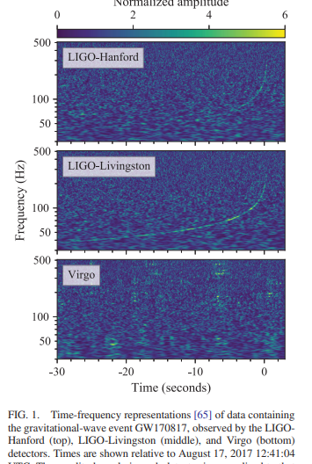

GW170817: A very very special GW event
Position localization ~ 28 deg²
arXiv:1710.0583
A 𝛄-ray burst was observed 1.7seconds after the merger !!!
→ A plethora of MM observations !!

Slide 8
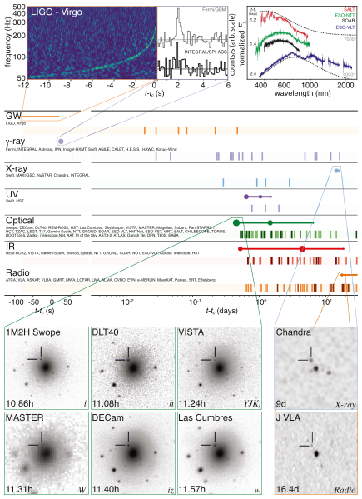
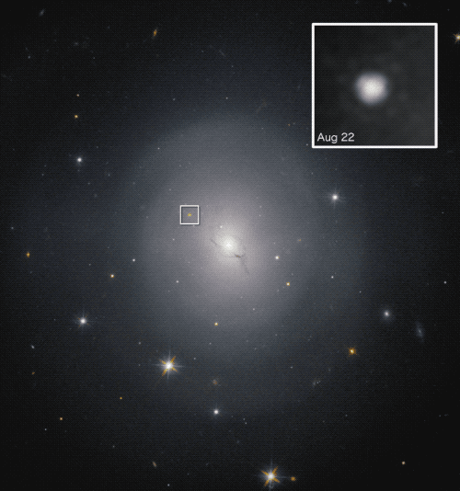
GW170817,GRB170817A, EM170817 have inaugurated the era of Multi-Messenger GW Astronomy
Hubble observations of NGC 4993
Critical KGWG contributions
Im et al.
Troja et al. ++
Optical afterglow powered by the radioactive decay of heavy r-process nuclei
Spectral evidence for strontium productions!!!

Slide 9
GW170817 induced MM GW Astronomy is having fundamental Implications for Physics, Astrophysics & Cosmology (arXiv:1710.05832) !!
This is despise the fact that the observed GWs lasted around 100 seconds & the source was at ~40 Mpc!!
A very very special GW event

Slide 10
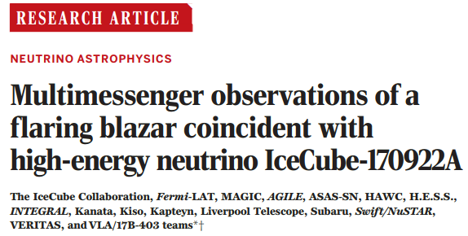
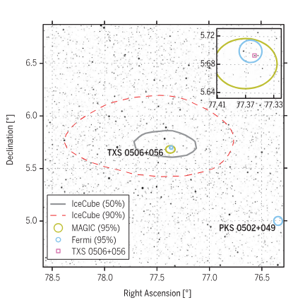
Multi-Messenger 𝜈 Astronomy ( arXiv:1807.08816 )
Hwang, Im ++
Muon track detections -> ~a 290 TeV 𝜈 & follow-up MAGIC observations reveal 400 GeV γ-rays from TXS 0506+056

Slide 11
Team Eccentric’s interests are on such events
&
We employ General Relativistic inputs to analyse observational implications of such events

Slide 12

Maturing Pulsar Timing Array efforts hold a very bright promise
Era of Persistent Multi-Messenger GW Astronomy is FAST approaching

Slide 13
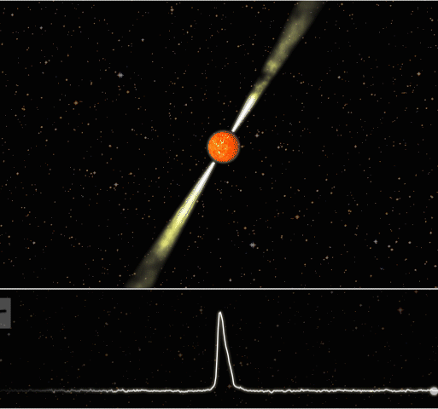
Pulsar Timing Array (PTA): How does it work?
Observe a bunch of MSPs at different locations in the sky using the best radio telescopes of our times
Residuals due to GWs
are correlated with quadrupolar nature
PTR -> differences between the predicted and the measured TOAs
Search for the correlated timing residual for detecting nHz GWs
Image Source: Internet

Slide 14
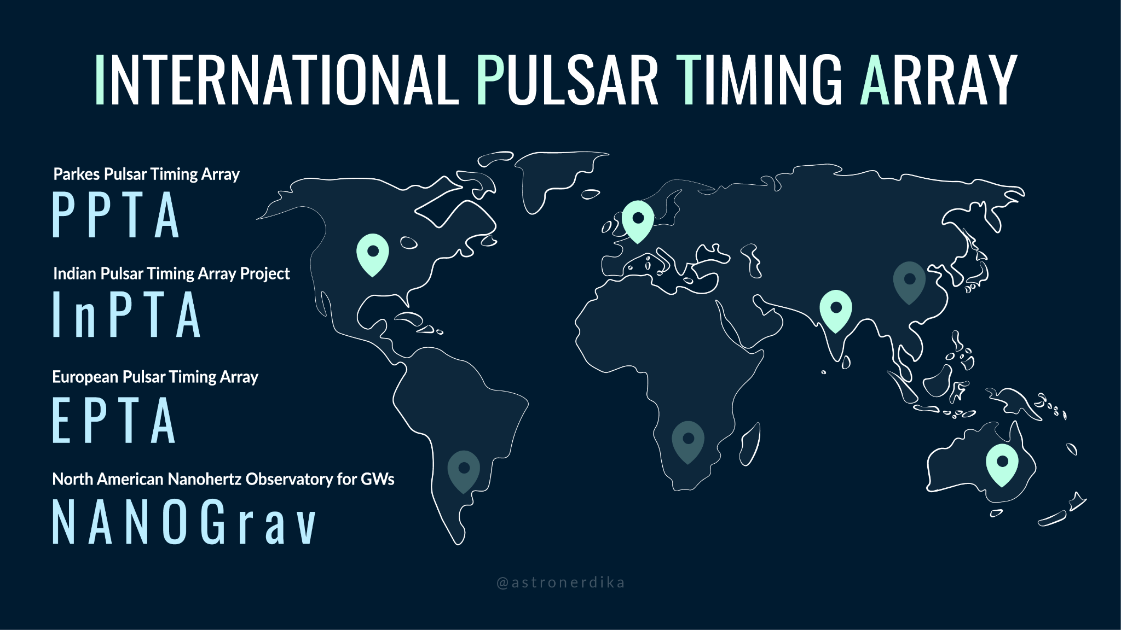
Our nano-Hz GW sources are SMBH binaries

Slide 15
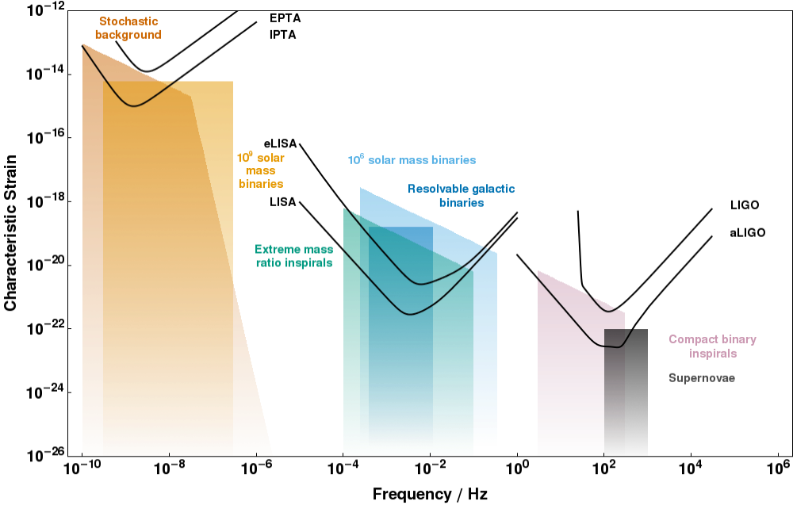
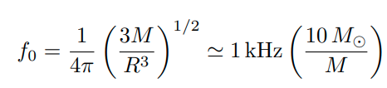

Astrophysical GW Spectrum (nano to hecto-Hz)
h = 𝚫L/L
GW strain
We measure changes in the light travel times induced by GWs
http://gwplotter.com
Notes:
Observable astrophysical GWs can be from nano to kilohertz windows. Man-made GW observatories are sensitive to mHz- KHz regime. However, If you want to see the nano-Hertz GWs spectrum, you need PTA. LIGO-LISA are sensitive to GWs around steller mass and massive BHB. Whereas, PTA is sensitive to SMBHBs. I will mostly be focussing on PTA.

Slide 16
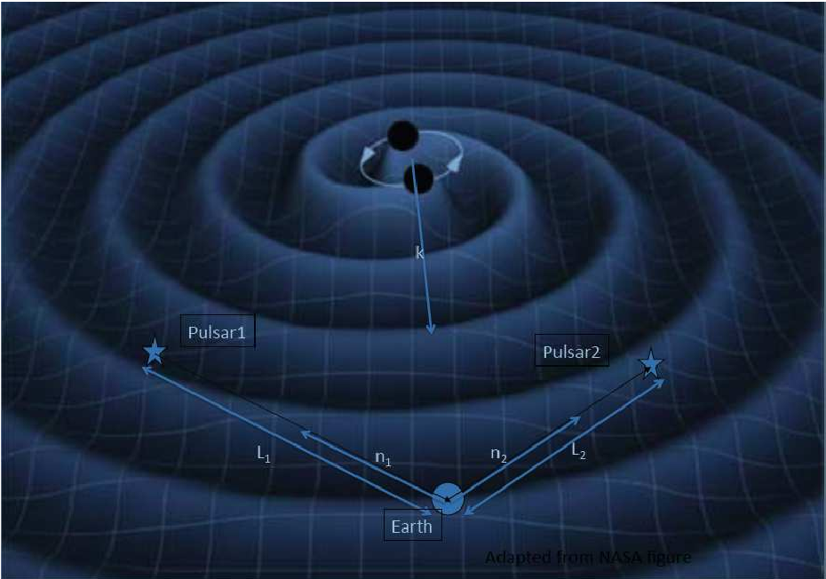


Pulsar Timing Arrays for nano-hertz GW Astronomy
SMBH binaries can provide nano hertz GWs with amplitudes ~10⁻¹⁵
Detweiler, S. (1979)
We need highly accurate and stable celestial clocks
Employ An Array of Milli-Second Pulsars!!
Courtesy: Web

Slide 17
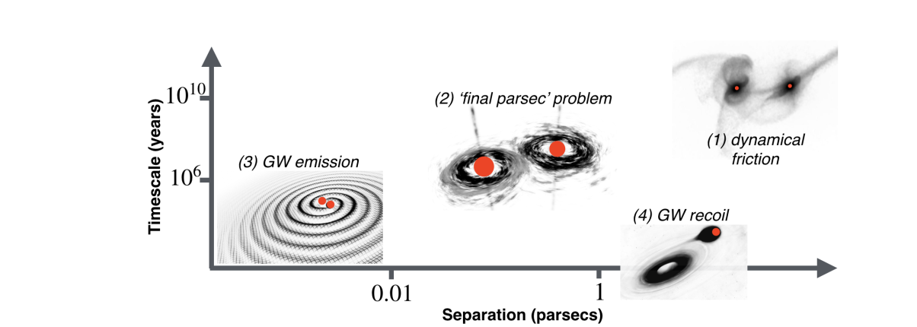
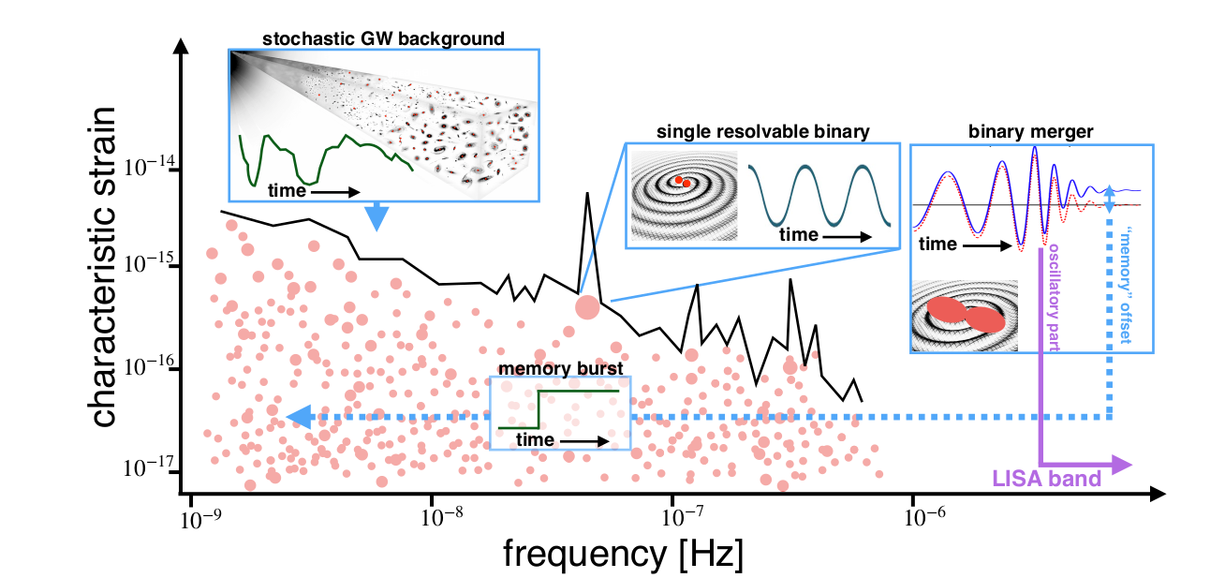
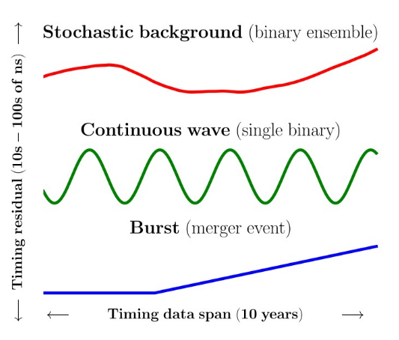
Maturing IPTA efforts should lead many persistent MM events at cosmological distances
arXiv:1903.08183; Taylor+
At present, we are trying to inaugurate the era of nHz GW astronomy

Slide 18
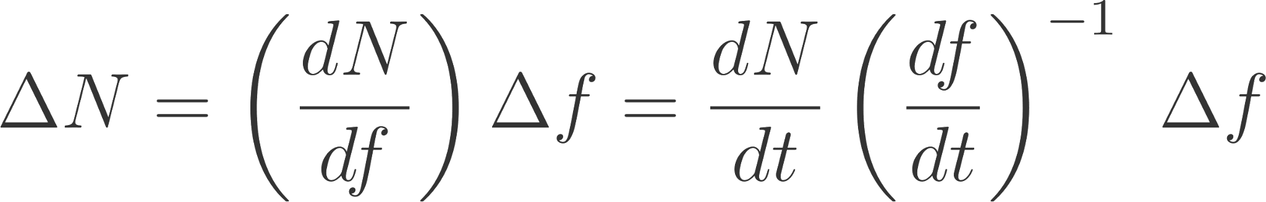
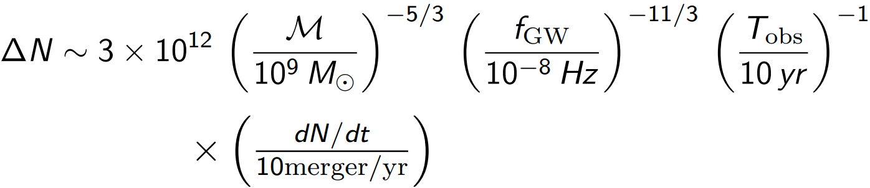
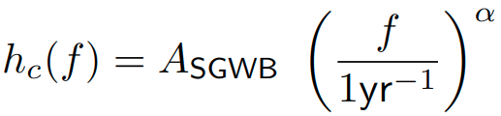
Why Stochastic GWB ?
Galaxy mergers can lead to merger of their constituent SMBHs.
Rough estimate for the number of binary BHs (ΔN) in a frequency interval
Δ 𝑓 =1/T_{obs} such that .
This is clearly >>1,
Evidence for SGWB appears as low frequency stochastic signal common to all Pulsars (CRN)
[Sathyaprakash,+," Living reviews in relativity 12.1 (2009): 1-141.]
; 𝛼=-⅔ for MBH binaries in circular inspiral.
Notes:
Let me explain why we expect SGWB. Galaxies are expected to host massive BHB. Galaxies are also expected to merge, which leads to the merger of their constituent SMBHs. We can estimate the rough number of BBHs in a frequency interval which is the inverse of the observation window. We are using the quadrap[olar expression of df/dt. Even if the merging rate is 1/yr, it does not matter.
Show less

Slide 19
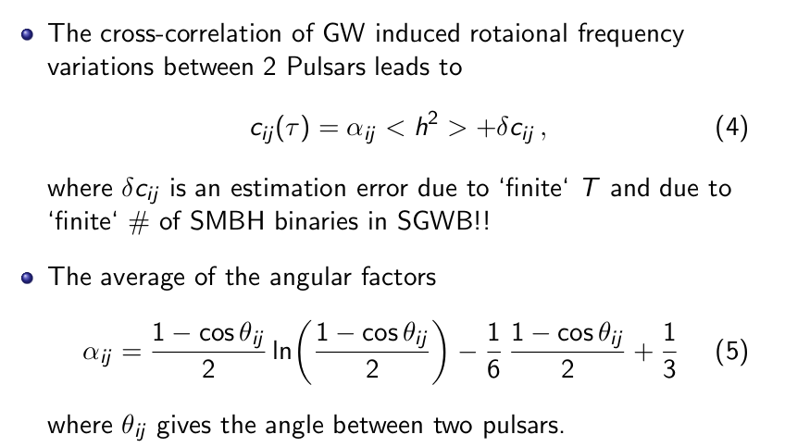
Convert CRN → SGWB with GR Inputs
⇦ Cross correlation enhances the signal strength
⇦ Helling-Downs Correlation

Slide 20
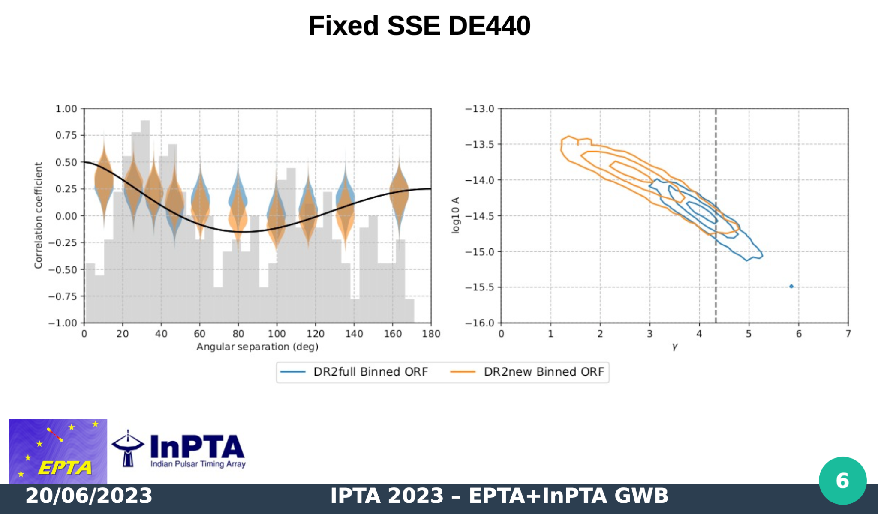

We (InPTA) combined our resources with EPTA for the 3P+ efforts
to clarify the nature of an earlier observed CRN in many MSPs
(NANOGrav, EPTA+InPTA, PPTA ) + CPTA; MPTA
A ~ (2.5±0.7)×10⁻¹⁵ @ 1yr−1.
InPTA provided indigenous data, algorithms and theoretical constructs to these 3P+ efforts
arXiv:2306.16214 ( A&A 2023)

Slide 21
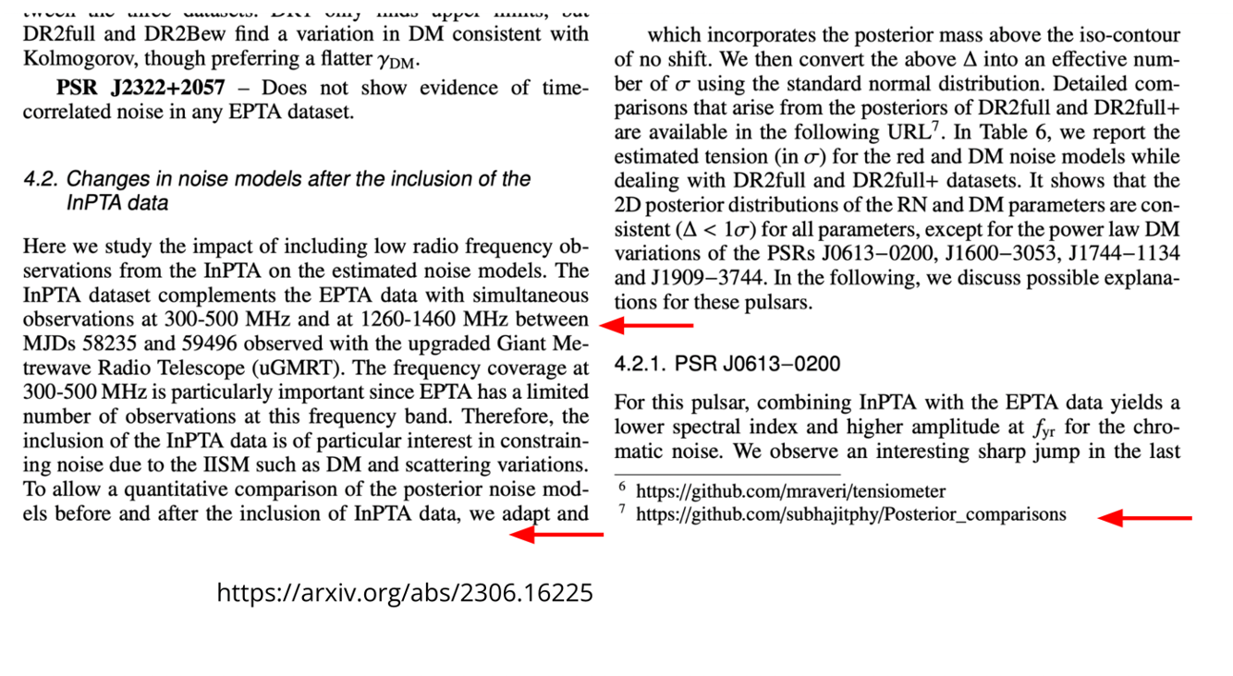
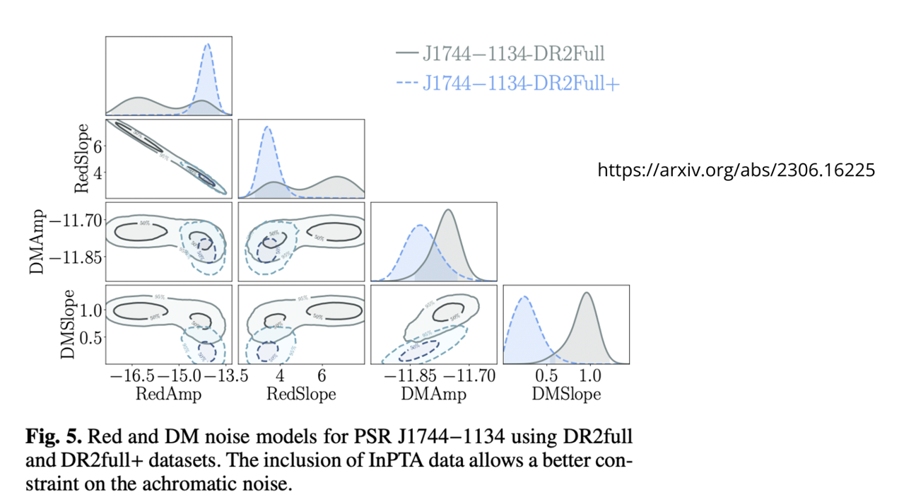
InPTA provided indigenous data, algorithms and theoretical constructs to these 3P+ efforts

Slide 22
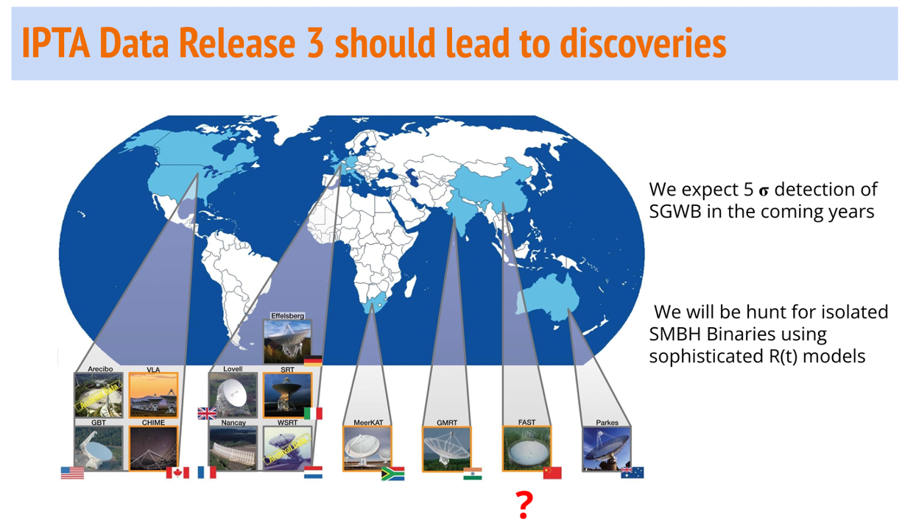
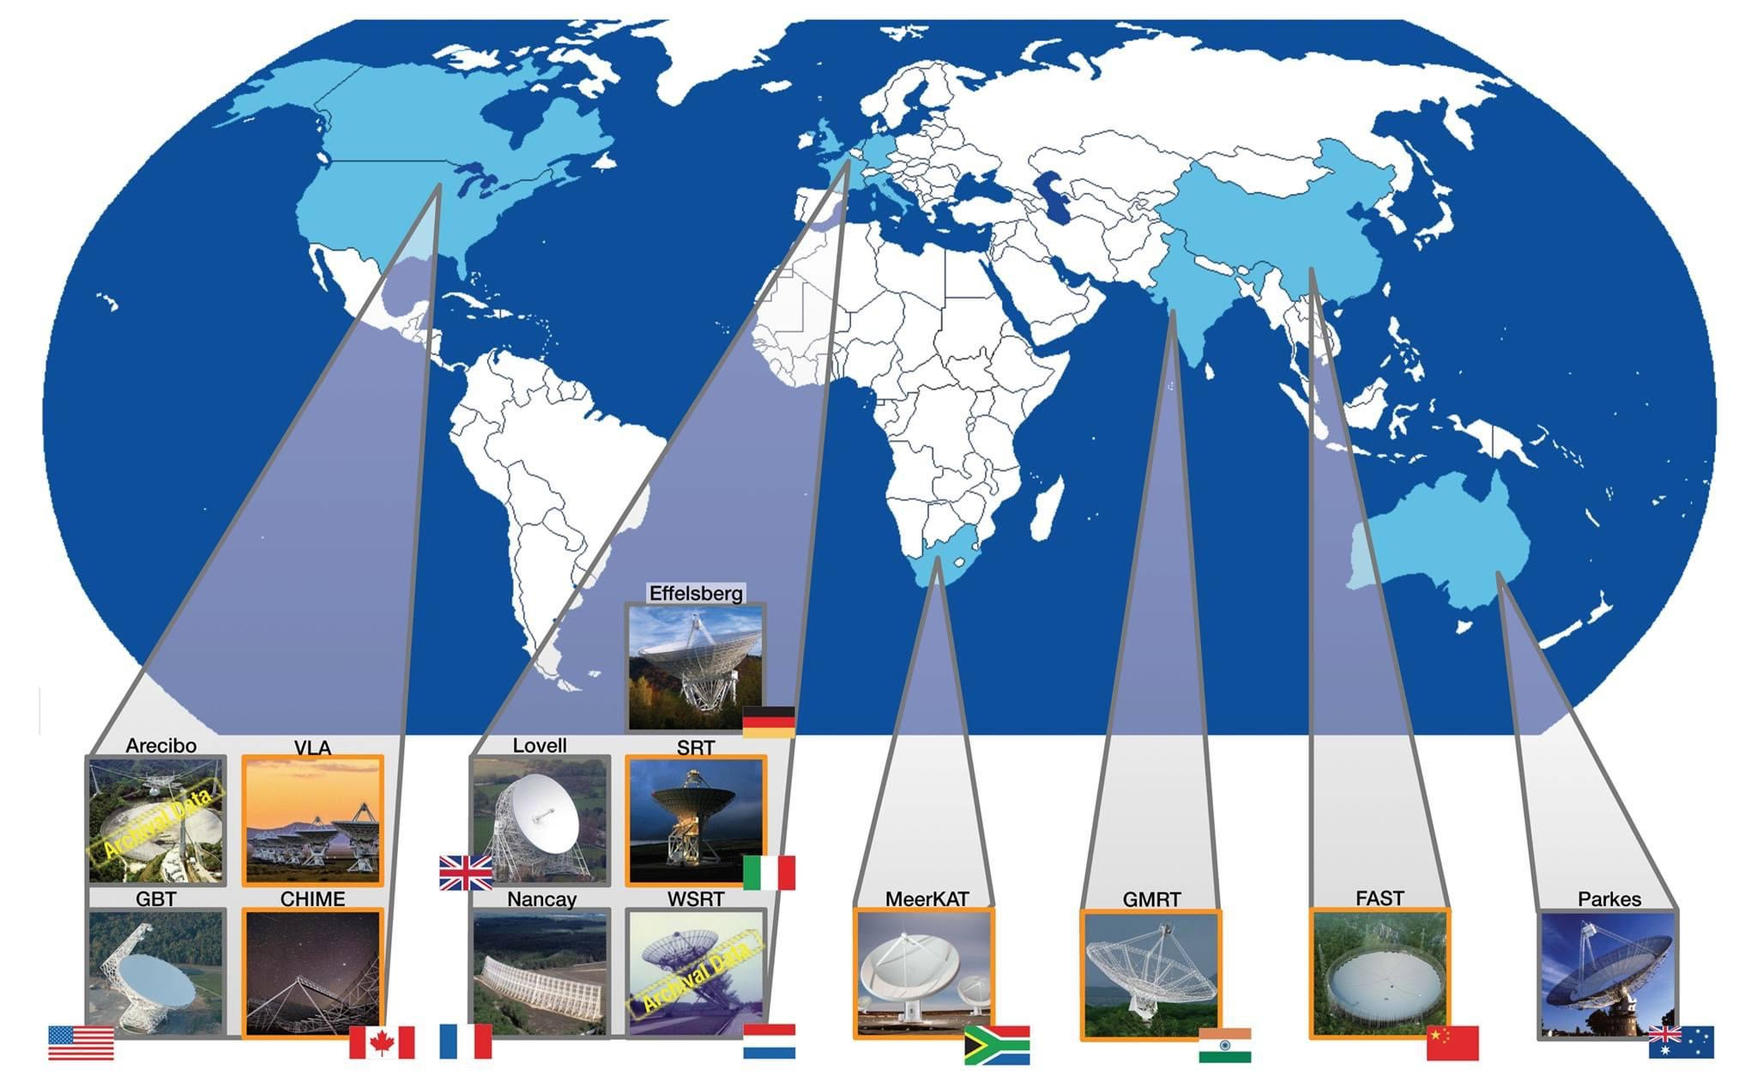
IPTA Data Release 3 should lead to discoveries
i) Aman Srivastava
ii) Subhajit Dandapat
iii) Abhimanyu S
iv) Lankeswar Dey
Co-leads of DR3 GWA
efforts
CPTA is part of DR3!!

Slide 23
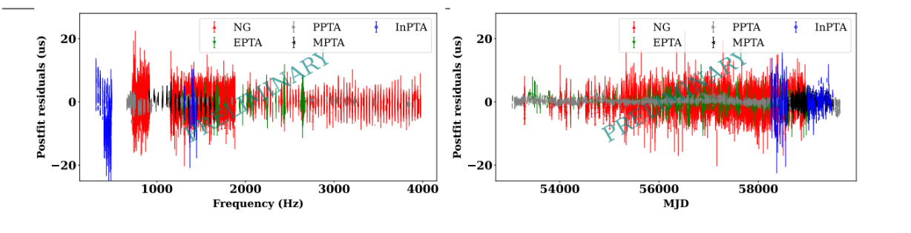
Why are we so confident?
We are now part of GWIC due to these efforts
Prerna is leading our DR2 efforts

Slide 24

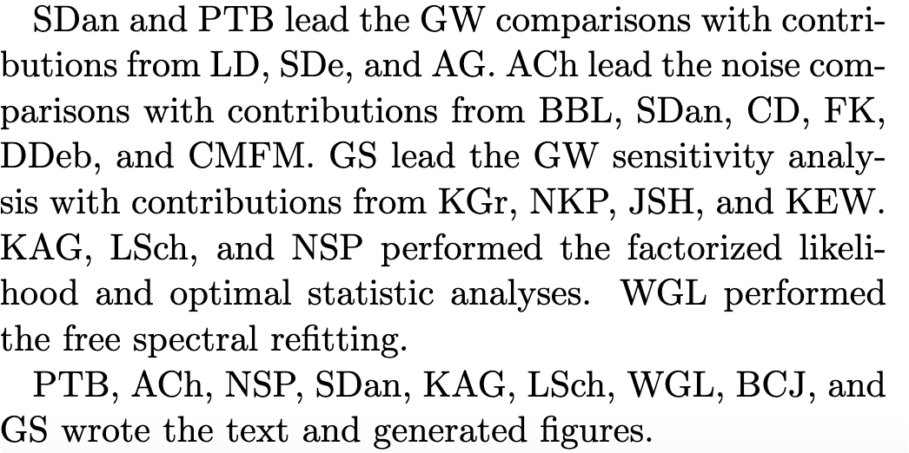
InPTA’s first IPTA paper. (arXiv:2309.00693)
Aman Srivastava,
Subhajit Dandapat
Lankeswar Dey
Abhimanyu S
are co-leading
a few DR3 GWA efforts

Slide 25
Single GW source searches show hints of a possible source at 4.2 nHz with A~10⁻¹⁴
arXiv:2305.19318 (Dandapat + )

Slide 26
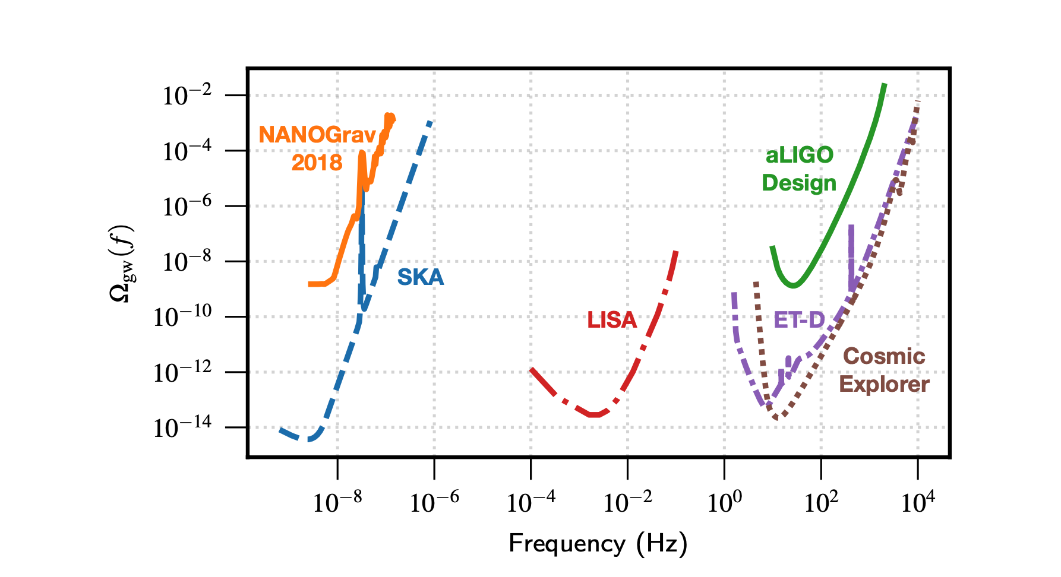
SKA era PTA will have important implications for MM GW Astronomy
arXiv:1911.09745

Slide 27
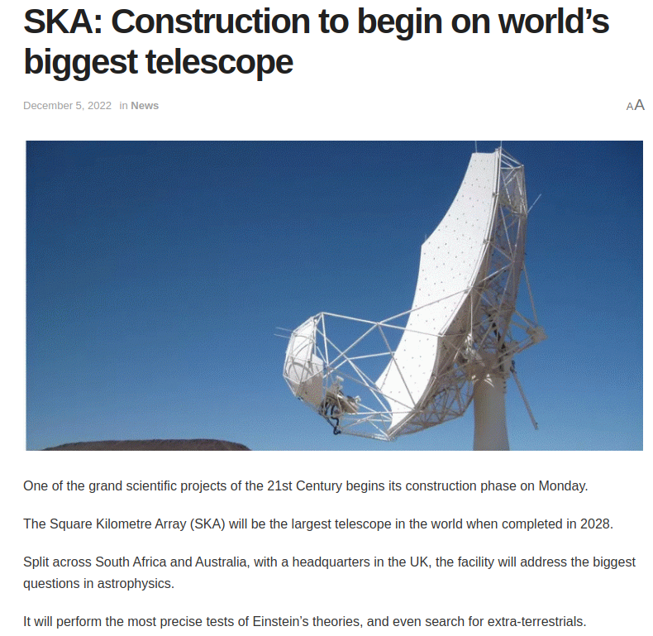
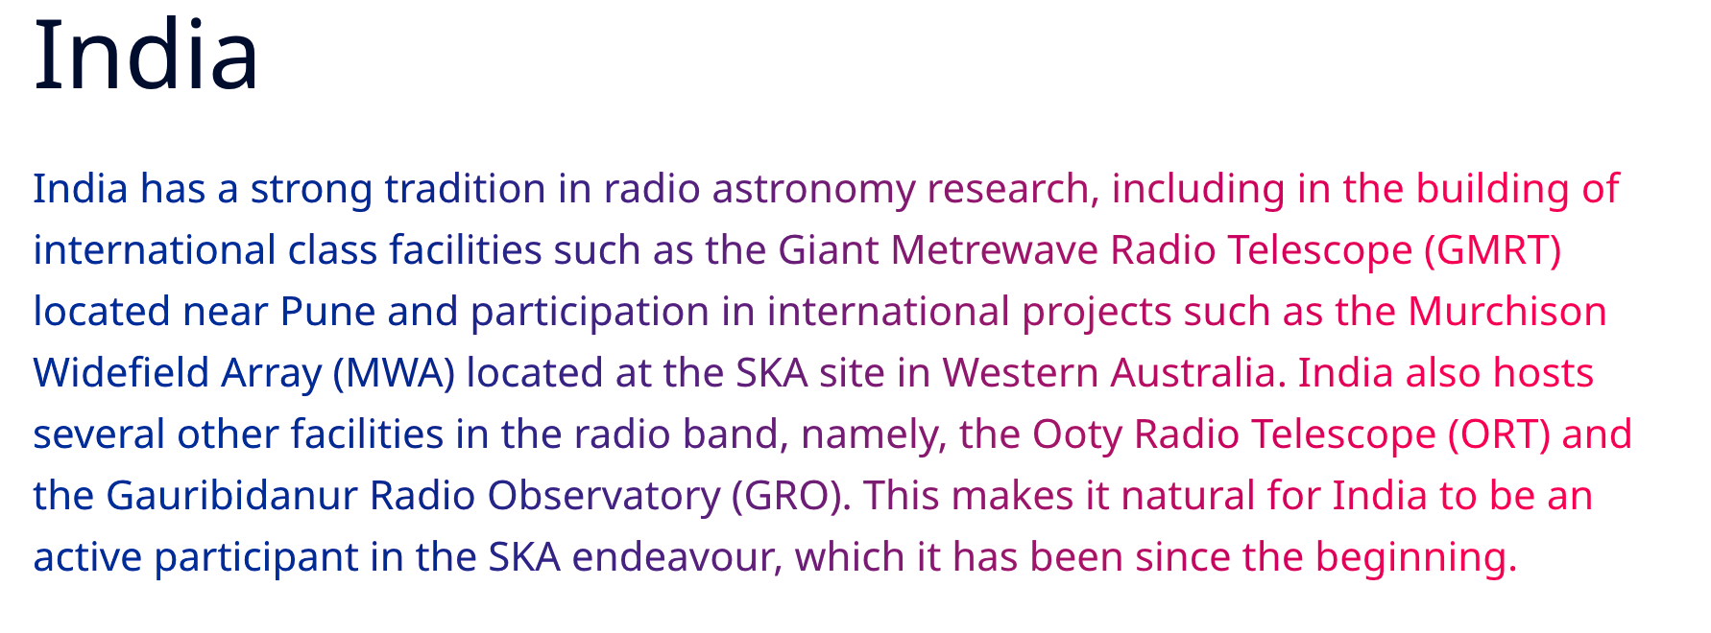


Slide 28
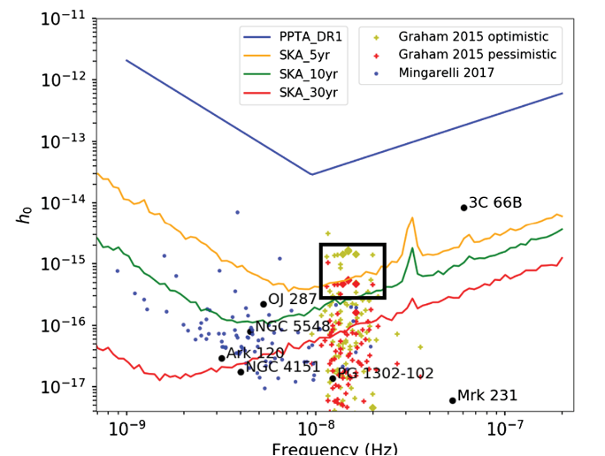

nHz GW emitting SMBH binary candidates can usher in the era of persistent MM GW Astronomy
Feng,Li + (20)

Slide 29
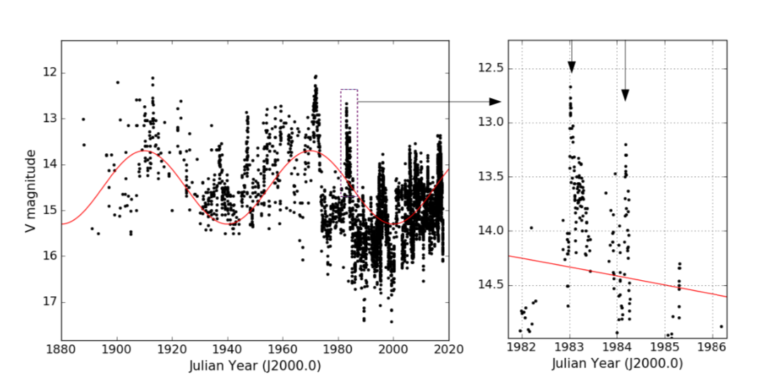
Unique Blazar OJ 287
OJ 287 is a bright blazar at a redshift of z ~ 0.3.
Its 130 years long optical lightcurve shows two periodic variations.
Dey et al. 2018
Quasi-periodic double-peaked high brightness flares with period ~ 12 years
Long term variations with 60 years period

Slide 30
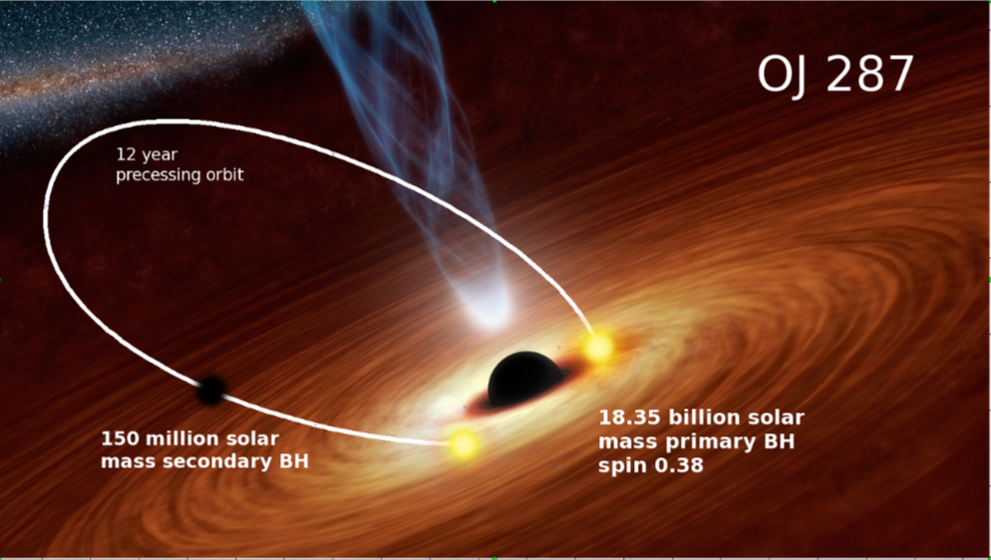
Binary black hole central engine model of OJ 287
When the secondary BH impacts with the accretion disk of the primary, hot gas bubbles come out of the disk on both sides.
Those hot bubbles expand, become optically thin and radiate strongly near the optical regime. This causes the flares.
Lehto & Valtonen 1996 model

Slide 31
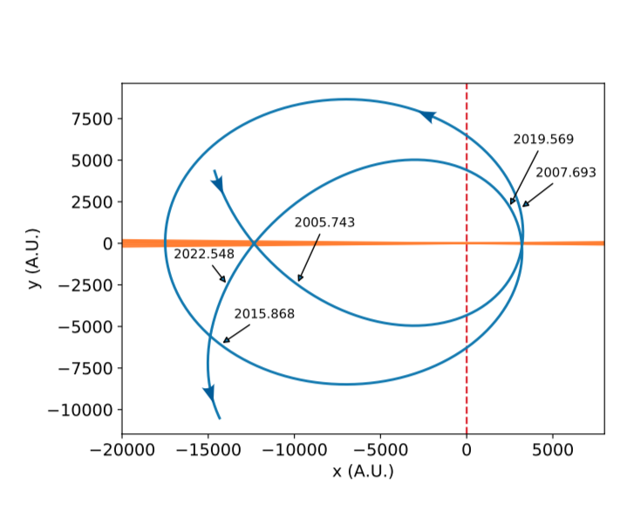
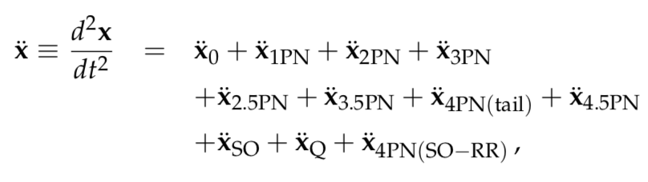
Secondary orbit can be tracked using GR
The orbit is calculated using post-Newtonian (PN) accurate dynamics!
n-PN ~ O {(v/c)^{2n}}
In 2018, we predicted that the next SMBH impact would occur in
July 31, 2019 (Dey et al. 2018).

Slide 32
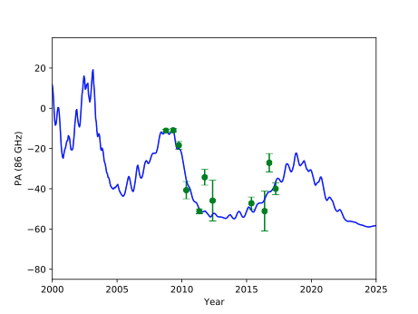
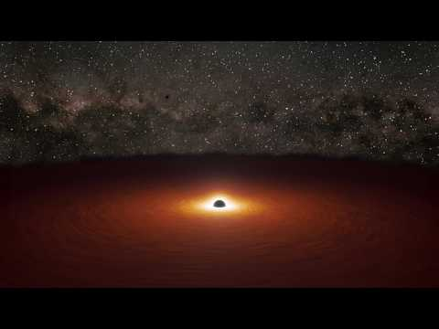
Credit: NASA/JPL & Abhimanyu S (TIFR)
Wait for our EHT/GMVA results on
OJ 287’s
Position Angle evolution
Spitzer Space Telescope observations confirmed the possibility that OJ 287 is hosting SMBH binary that emits nano- hertz GWs ( Laine, Dey, Valtonen + 2020)

Slide 33
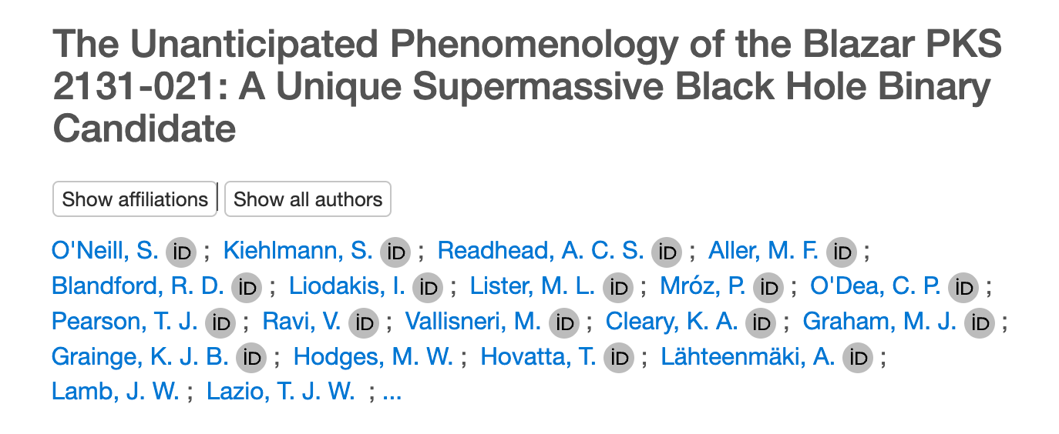
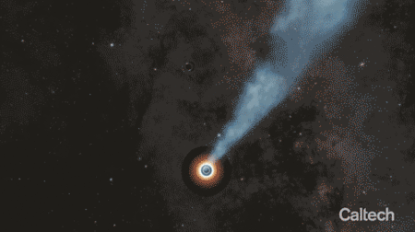
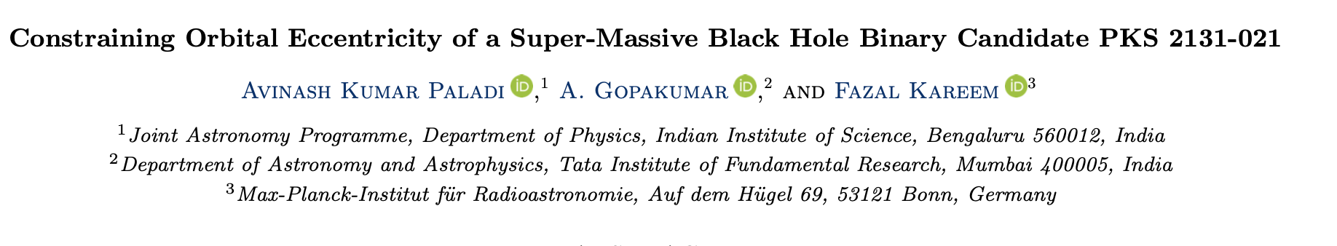
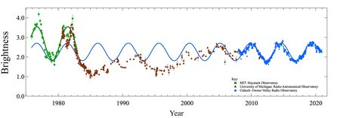
Are there other nHz GW emitting SMBH binaries ?
SKA era IPTA should be able to detect nHz GWs from many such SMBH binaries

Slide 34
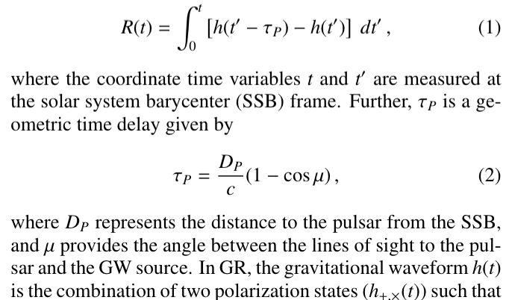
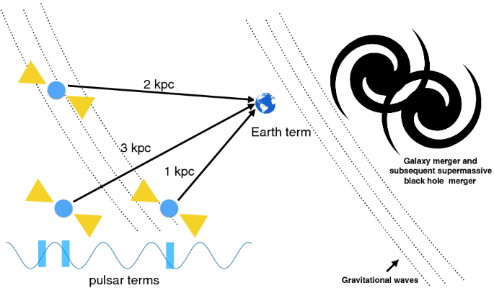
Modeling the expected R(t) from SMBH binaries in general relativistic eccentric orbits is critical
Abhimanyu S + (20,23); Dey, Abhimanyu + (2025)

Slide 35
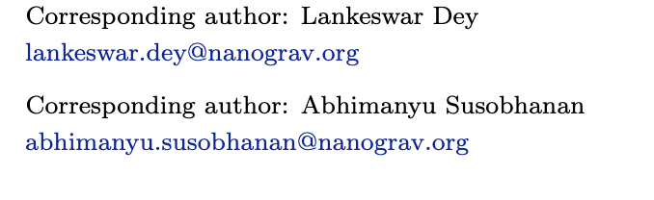

arXiv:2309.17438
InPTA is leading IPTA efforts on individual SMBH binaries

Slide 36

We are taking a closer look

Slide 37

We keep an for possible nHz GW emitting SMBH binaries
Can we
constrain its tiny e?
Kareem,Paladi+

Slide 38


SKA era PTA should witness lensing events ++
Imagine science benefits of observing persistent nHz GW sources in EM & ν windows
λ_{GW} ~ Sch Radius of lens galaxies ..No multiple events
Different EM & GW lensed events!! [ Ma,Lu, Chen,Chen (2023)]

Slide 39


Pulsar Timing & Neutrino Astronomy: (?)
Anisotropic neutrino emission from a core-collapse supernova should cause a permanent change in the local space-time metric
→ a linear gravitational wave (GW) memory event
( Richardson + 22)
Critical GR inputs were derived in collaboration with H M Lee & Gihyuk Cho

Slide 40

Close Asian Collaborations will be critical to GW astronomy
Asia is hosting Ground, Space & Galaxy based GW observatories
uGMRT, FAST, TNRT, QTT, FAST Core Array ++++
Thanks to APCTP & Academia Sinica
We hope to host many such meetings

Slide 41
I am grateful to Prof. Hyung Mok Lee & his colleagues who introduced me to GW related efforts in South East Asia
Looking forward to deepening Asian collaborations
on all facets of GW astronomy
Thank you very much

Slide 42
Indian Pulsar Timing Array (InPTA) for nHz GW Astronomy
( https://inpta.iitr.ac.in/ )
InPTA is a frugal (& indigenous) consortium that employs niche abilities of TIFR’s upgraded GMRT to inaugurate the era nano-hertz Gravitational Wave Astronomy in the very near future
InPTA is contributing the world-wide effort to detect and characterise a diffuse GW background due to merging Super Massive Black Hobe binaries with the help of indigenous data, analysis algorithms & theoretical constructs
We aim to pursue persistent multi-messenger nHz GW astronomy in the era of Square Kilometre Array/DSA200 IPTA , IceCube-Gen2, KM3NeT, ngEHT, Great Observatories ++

Slide 43


G. Swarup et al. 1991, Current Science, Vol. 60, pp. 95-105
InPTA efforts, conceptualised by Bhal Chandra Joshi , are constantly inspired by Prof. Swarup: Our Supreme Visionary Without Parallel
Credit: Prerna Rana

Slide 44


We have some interest in pure inspiral events like GW170817
P. Hemantakumar+ 24

Slide 45

This amazing adventure is driven by
Youngsters
Thank you for the privilege of your time

Slide 47

Probing the SMBH binary scenario with a plethora of observations!!
The predicted July 2022 impact flare could NOT be monitored due to OJ 287’s solar elongation!!
arXiv:2308.03017
Did we see superposition of primary & secondary jets during late 2020?
3 flares within 7 years; a unique prediction due to the general relativistic precession!!

Slide 48
Why Stochastic GWB ?
Galaxy mergers can lead to merger of their constituent SMBHs.
Rough estimate for the number of binary BHs (ΔN) in a frequency interval
Δ 𝑓 =1/T_{obs} such that .
This is clearly >>1,
Evidence for SGWB appears as low frequency stochastic signal common to all Pulsars (CRN)
[Sathyaprakash,+," Living reviews in relativity 12.1 (2009): 1-141.]
; 𝛼=-⅔ for MBH binaries in circular inspiral.
Notes:
Let me explain why we expect SGWB. Galaxies are expected to host massive BHB. Galaxies are also expected to merge, which leads to the merger of their constituent SMBHs. We can estimate the rough number of BBHs in a frequency interval which is the inverse of the observation window. We are using the quadrap[olar expression of df/dt. Even if the merging rate is 1/yr, it does not matter.
Show less

Slide 49
Convert CRN → SGWB with GR Inputs
⇦ Cross correlation enhances the signal strength
⇦ Helling-Downs Correlation

Slide 50

Bhal Chandra is the present chair of the PSR WG
InPTA youngsters will drive many of persistent MM nHz GW Astronomy efforts

Slide 51

Blazar OJ 287 is a strong candidate to host a nHz GW emitting SMBH binary!!
Thanks to multi-band EM observational campaigns prompted by detailed theoretical investigations
Valtonen,Dey+ 23
Credit: Bob King

Slide 52
Unique Blazar OJ 287
OJ 287 is a bright blazar at a redshift of z ~ 0.3.
Its 130 years long optical lightcurve shows two periodic variations.
Dey et al. 2018
Quasi-periodic double-peaked high brightness flares with period ~ 12 years
Long term variations with 60 years period

Slide 53
Binary black hole central engine model of OJ 287
When the secondary BH impacts with the accretion disk of the primary, hot gas bubbles come out of the disk on both sides.
Those hot bubbles expand, become optically thin and radiate strongly near the optical regime. This causes the flares.
Lehto & Valtonen 1996 model

Slide 54
Secondary orbit can be tracked using GR
The orbit is calculated using post-Newtonian (PN) accurate dynamics!
n-PN ~ O {(v/c)^{2n}}
We showed that 4PN-tail terms in the EOM are important to accurately predict the flare timings (Dey et al. 2018).

Slide 55


The flare is predicted to peak in July 31 2019
&
We even predicted the shape of its light curve!!

Slide 56


Slide 57

The predicted & observed 2019 BH impact flare
We observed OJ 287 with
the Spitzer Space Telescope during the predicted time
Spitzer observations strongly supports the arrival of the predicted flare (within the expected time window)
Laine, Dey et al. 2020 (arXiv:2004.13392 )

Slide 58


Credit: NASA/JPL & Abhimanyu S (TIFR)
Spitzer Space Telescope `performed` a test of General Relativity

Slide 59

OJ287 should be a promising SMBH Binary IPTA (SKA) /ngEHT era
We have done Multiple multi ƛ observational campaigns for tracking the predicted impact flares (07,15,19)
→ A SMBH binary that emits nano- hertz GWs in blazar OJ 287!!
Are there any other way to test our SMBH binary scenario for OJ 287?
( Dey + 21, arXiv:2103.05274 )
Valtonen+ 07, Valtonen+09, Valtonen+ 15; Dey, Valtonen + 2018, Laine, Dey +. 2020

Slide 60



PA variation in jet of OJ 287
Variation of angular momentum of the inner region of the accretion disk
Variation in position angle in of the jet in OJ 287
(Dey + 21, arXiv:2103.05274)

Slide 61
PA variations of OJ 287’s jet
Variation of angular momentum of the inner region of the accretion disk
Variation in position angle in of the jet in OJ 287

Slide 62
PA variations of OJ 287’s jet
Variation of angular momentum of the inner region of the accretion disk
Variation in position angle in of the jet in OJ 287
(Dey + 21, arXiv:2103.05274)

Slide 63
Credit: NASA/JPL & Abhimanyu S (TIFR)
OJ 287 is a bright blazar at z ~ 0.3.
Wait for our EHT/GMVA results on
OJ 287’s
Position Angle evolution
Spitzer Space Telescope observations supported the possibility that
OJ 287 may be hosting SMBH binary that emits nano- hertz GWs
(Laine,Dey, Valtonen, AG+ ; ApJL, 2020)

Slide 64




Wait for our GMVA/EHT results
Jose Gomez, +
IPTA’s efforts during SKA & DSA 2000 era should be very critical to probe our SMBH Binary central engine description for OJ 287

Slide 65
Modeling the expected R(t) from SMBH binaries in general relativistic eccentric orbits is critical
Abhimanyu S + (20,23); Dey, Abhimanyu + (2024)

Slide 66


Slide 67
arXiv:2309.17438
InPTA is leading IPTA efforts on individual SMBH binaries

Slide 68
SKA era PTA should witness lensing events
Several lensed events??
λ_{GW} ~ Sch Radius of lens galaxies ..No multiple events
Different EM & GW lensed events!! [ Ma,Lu, Chen,Chen (2023)]

Slide 70
Slowly Inspiralling Massive Black Hole Binaries are of definite interest to both SKA era IPTA, ngEHT, IceCube-Gen2 & Great Observatories++
They (&InPTA efforts) will be critical to pursue persistent multi-messenger GW Astronomy

Slide 71
InPTA’s first IPTA paper. (arXiv:2309.00693)
Aman Srivastava,
Subhajit Dandapat
Lankeswar Dey
Abhimanyu S
are co-leading
a few DR3 GWA efforts

Slide 72
G. Swarup et al. 1991, Current Science, Vol. 60, pp. 95-105
InPTA efforts, conceptualised by Bhal Chandra Joshi , are constantly inspired by Prof. Swarup: Our Supreme Visionary Without Parallel
Credit: Prerna Rana

Slide 73
Indian Pulsar Timing Array (InPTA) for nHz GW Astronomy
( https://inpta.iitr.ac.in/ )
InPTA is a frugal (& indigenous) consortium that employs niche abilities of TIFR’s upgraded GMRT to inaugurate the era nano-hertz Gravitational Wave Astronomy in the very near future
InPTA is contributing the world-wide effort to detect and characterise a diffuse GW background due to merging Super Massive Black Hobe binaries with the help of indigenous data, analysis algorithms & theoretical constructs
We aim to pursue persistent multi-messenger nHz GW astronomy in the era of Square Kilometre Array/DSA200 IPTA , IceCube-Gen2, KM3NeT, ngEHT, Great Observatories ++

Slide 74
Join us in this amazing adventure
I am really grateful to my teachers & thank you for the privilege of your time

Slide 76
Probing the SMBH binary scenario with a plethora of observations!!
The predicted July 2022 impact flare could NOT be monitored due to OJ 287’s solar elongation!!
arXiv:2308.03017
Did we see superposition of primary & secondary jets during late 2020?
3 flares within 7 years; a unique prediction due to the general relativistic precession!!

Slide 77


Prof Bhal Chandra Joshi founded the collaboration
Unique strength of uGMRT:
High sensitivity at low frequencies
Ideal for studying frequency dependent effects dominant at low frequencies.
Indo-Japanese collaboration
Simultaneous multi-band MSP observations
Band 3 (300-500 MHz) + Band 5 (1260-1460 MHz)
Presently observing 22+ IPTA pulsars ( Cadence: 10-14 days )

Slide 78

InPTA first data release: InPTA DR1
J0613-0200
J1012+5307
J1600-3053
J1713+0747
J1857+0943
J1939+2134
J2145-0750
Data:
    Dispersion measure (DM)
    Time of Arrival (ToA) of pulse
    Timing residual=(observed ToA - expected ToA)
J0437-4715
J0751+1807
J1022+1001
J1643-1224
J1744-1134
J1909-3744
J2124-3358
Band 3 (300-500 MHz) +
Band 5 (1260-1460 MHz)
Bandwidth = 200MHz
https://inpta.iitr.ac.in/
Ref: P. Tarafdar, K. Nobleson, P. Rana, et al. 2022, PASA, 39, e053

Slide 79

DM time series for 14 InPTA pulsars
DMs precision
10⁻⁴ to 10⁻⁶ pc-cm⁻³
Highest precision DM time series with the IPTA
Ref: P. Tarafdar, K. Nobleson, P. Rana, et al. 2022, PASA, 39, e053

Slide 80


Slide 81
From Siyuan Chen’s talk @ IPTA 2023 Meeting

Slide 82

arXiv:2306.16214 (to appear in A&A)
We report evidence for a SGWB, with a Bayes factor of 60 (GWB vs CURN)
FAP ~ 0.1% (≳3σ significance)
If the spectral index is fixed at 13/3, its amplitude ~ (2.5±0.7)×10⁻¹⁵ at a reference frequency of 1yr−1.
The addition of the InPTA data yields better noise modelling

Slide 83

The amazing art of pulsar timing

Slide 84



Pulsar Timing & GWs
Pulsar timing = Tracking of pulsar rotation by very accurately measuring pulse arrival times (TOAs)
Passing GWs induces a shift in Pulsar’s intrinsic spin frequency 𝜈₀ ➩ 𝜈(t)
Timing residuals, induced by GWs, are given by
the time integral of Δ𝜈₀/𝜈₀.
Timing Residual R(t):
Source : astron.nl
[ Hobbs, & Dai 2017 (arXiv:1707.01615)
( We model the expected R(t) from SMBH Binaries using GR approaches )
Notes:
Before I talk about PTA, let me explain what is pulsar timing. It's a procedure by which we can track NS rotation very accurately from their ToA. GWs can change ToA, which can lead to timing residuals.

Slide 85
To begin with SGWB appears as a noise in individual pulsars!
→ A common noise-like signal
→ Spatially correlated noise yielding GW detection
We DO NOT detect transient high-significance events
PTAs are sensitive to broadly 3 Types of persistent GW signals
Courtesy: Web
When this happens, we will inaugurate the era of nano-hertz GW astronomy
We are NOT there yet 😊

Slide 86
Credit: NASA/JPL & Abhimanyu S (TIFR)
OJ 287 is a bright blazar at z ~ 0.3.
Wait for our EHT/GMVA results on
OJ 287’s
Position Angle evolution
Spitzer Space Telescope observations supported the possibility that
OJ 287 may be hosting SMBH binary that emits nano- hertz GWs
(Laine,Dey, Valtonen, AG+ ; ApJL, 2020)

Slide 87
OJ287 should be a promising SMBH Binary IPTA (SKA) /ngEHT era
We have done Multiple multi ƛ observational campaigns for tracking the predicted impact flares (07,15,19)
→ A SMBH binary that emits nano- hertz GWs in blazar OJ 287
Are there any other way to test our SMBH binary scenario for OJ 287?
( Dey + 21, arXiv:2103.05274 )
Valtonen+ 07, Valtonen+09, Valtonen+ 15; Dey, Valtonen + 2018, Laine, Dey +. 2020

Slide 88


arXiv:2306.16214 ( A&A 2023)
A ~ (2.5±0.7)×10⁻¹⁵ @ 1yr−1.

