Slide 1

Exploring New MeV Neutrino Sources
with a Water-based liquid scintillator Detector
2025. 08. 28
Workshop for the 10th Anniversary of the Discovery of Gravitational Waves and KGWG Assembly Meeting
CONTACT
Gwangeon Seong
Department of physics, Ewha Womans University
E-mail : geseong@ewha.ac.kr
Notes:
Hello everyone, my name is Gwangeon Seong from Ewha Womans University.
I would like to introduce a theoretical study related to neutrino astronomy, which is also introduced by Prof Kyujin Kwak today, and This is a further details part of that presentation. The title of my talk is “Exploring New MeV Neutrino Sources with a Water-based Liquid Scintillator Detector.”

Slide 2
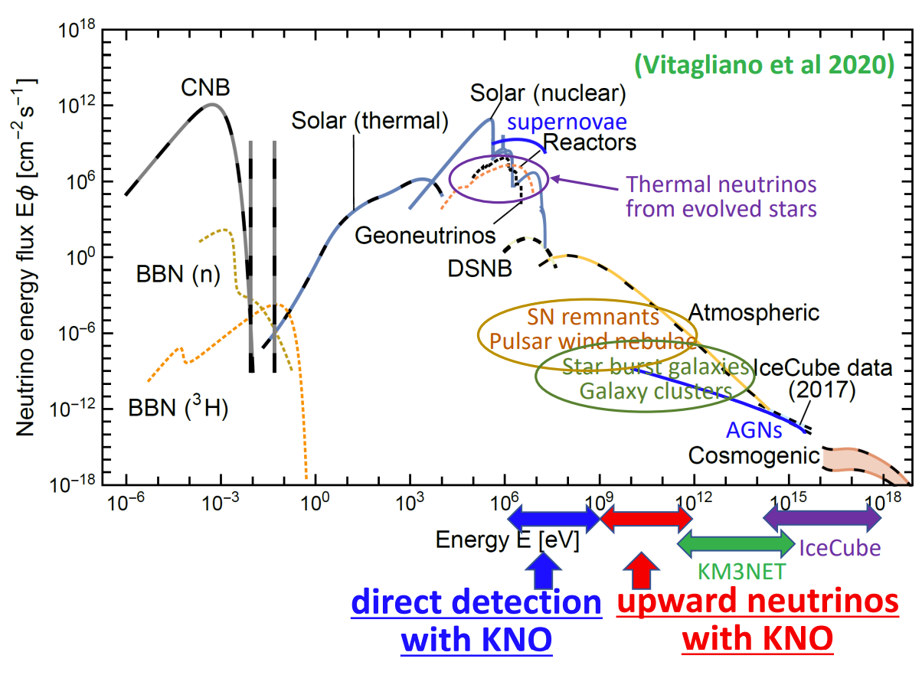
Motivation
MeV neutrino (𝝂)
  Only Sun and
  SN1987A
  “Are there other sources that could be detected in next-generation underground detectors?”
~ MeV
~ GeV
~ MeV
~ GeV
Notes:
First of all, we gonna start with the simple motivation of this study. Neutrinos from astronomical sources are known as new messengers and they can travel to Earth with no or little interaction between other meterials. Depending on the physical process of neutrino production, their energies can span an broad range.
The detectable energy range of neutrinos depends on the type of detector. For example, the IceCube observes very-high-energy neutrinos at the scale of about 10^15 eV, while solar neutrinos lie in the MeV range and are primarily detected by underground experiments such as Super-Kamiokande.
But in this energy range, neutrino astronomy is limited so far. Actually, only two astronomical neutrino sources have been observed, the Sun, and the supernova SN1987A. But underground neutrino detectors are still continuing to advance, and because of them, the following question is naturally motivated: are there other astronomical sources of MeV neutrinos that we could hope to detect?

Slide 3
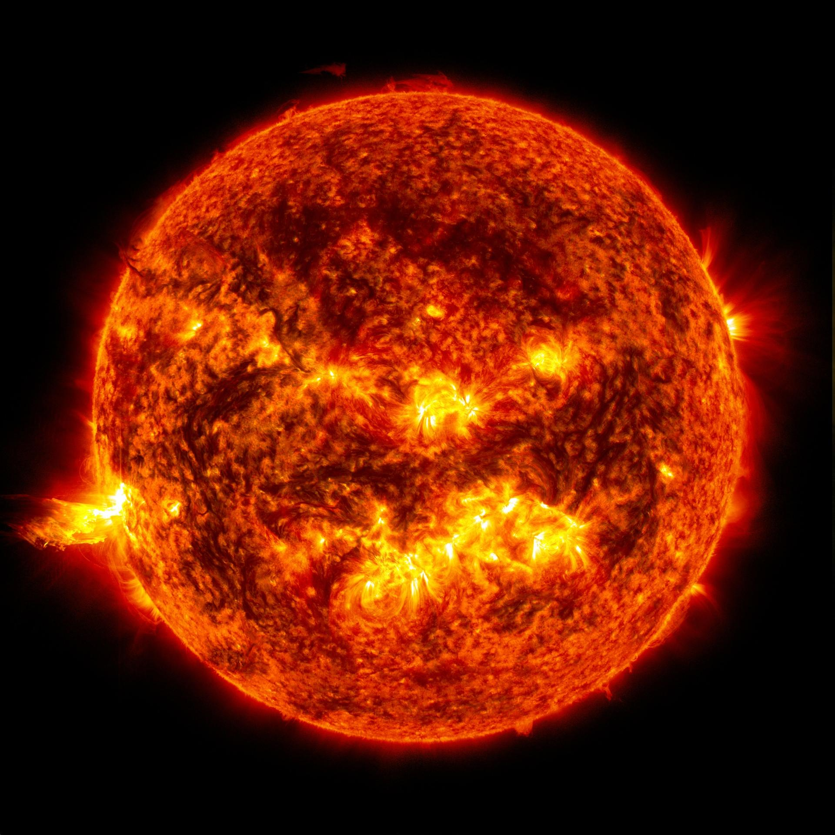
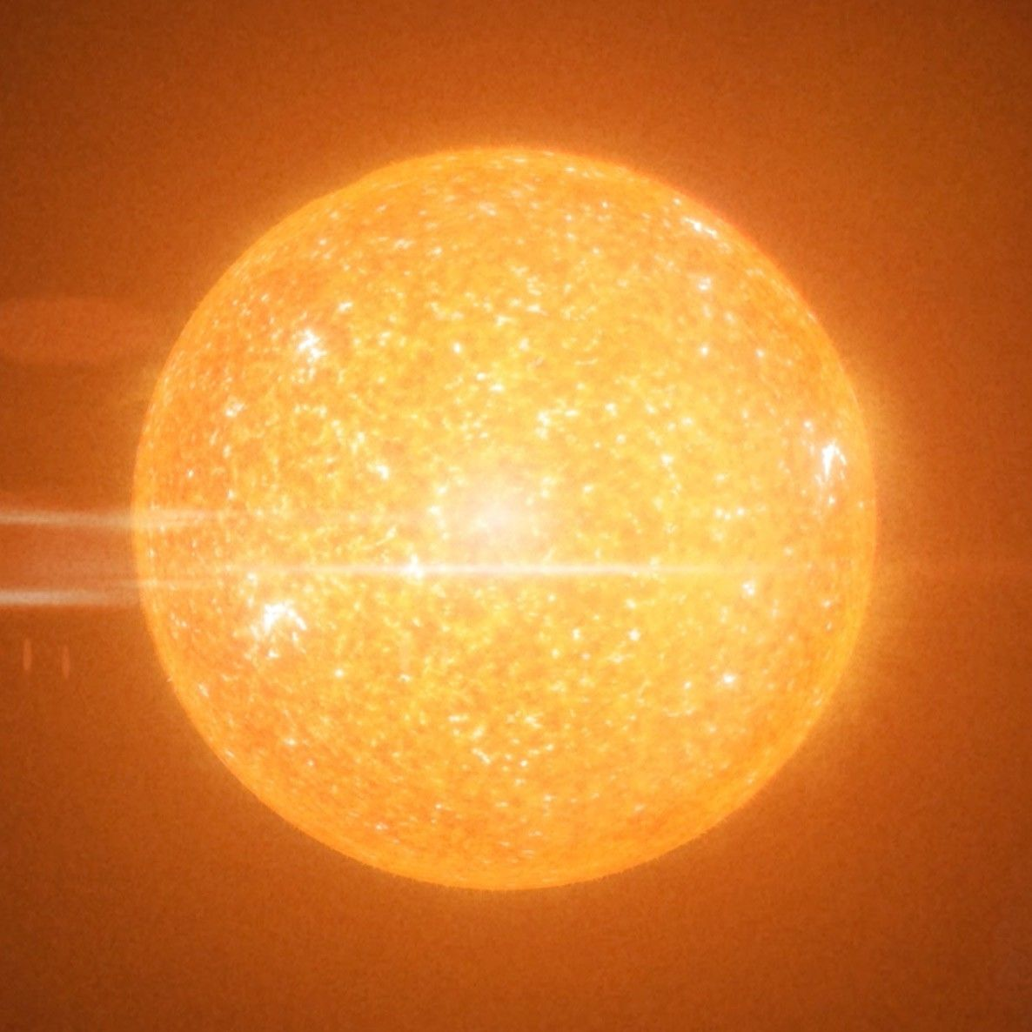
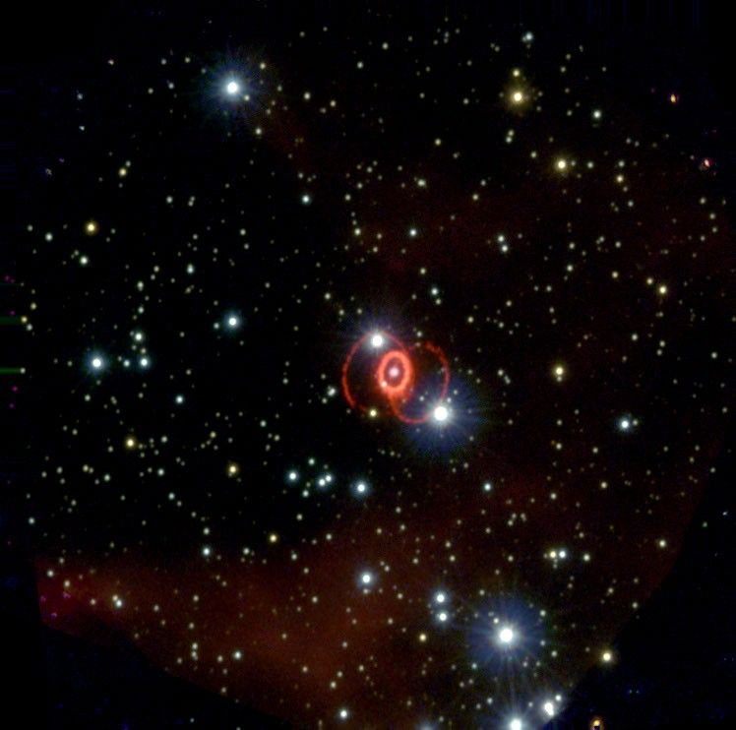
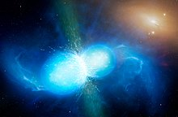
MeV Neutrino Source Candidates
Evolved Star
C, O, Si-burning phase
Credit: NASA
Credit: NASA
Sun
Sun
Credit: NASA
Credit: University of Warwick/Mark Garlick
Supernovae
Red supergiant
Neutron star merger
Notes:
When we consider possible sources, there are several candidates. The Sun is, of course, already known. Core-collapse supernovae are another obvious source, and compact binary mergers could also emit MeV neutrinos. Yet these transient events occur so rarely within our local neighborhood that detections are few and far between.
Possible candidate is another star, in particular Massive stars. They undergo continuous nuclear burning during their evolution, and in the later burning stages—carbon, oxygen, or silicon burning—they can emit significant number of MeV neutrinos. In this work, we aim to address the question of whether these neutrinos can be observed. Also Another possible candidate is the solar neutrino, but produced from the CNO cycle. In this talk, I’ll give you a quick look at what kind of science we can do once we detect them.

Slide 4
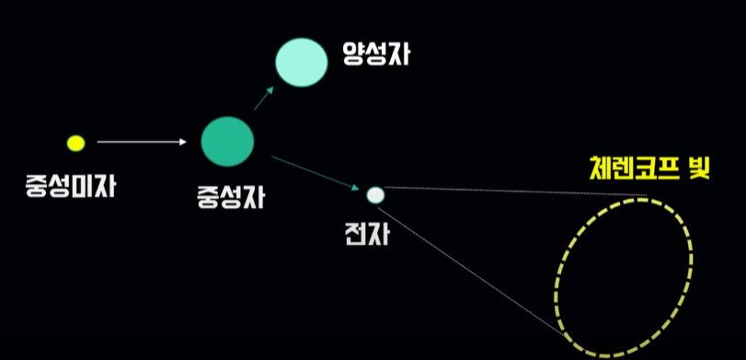

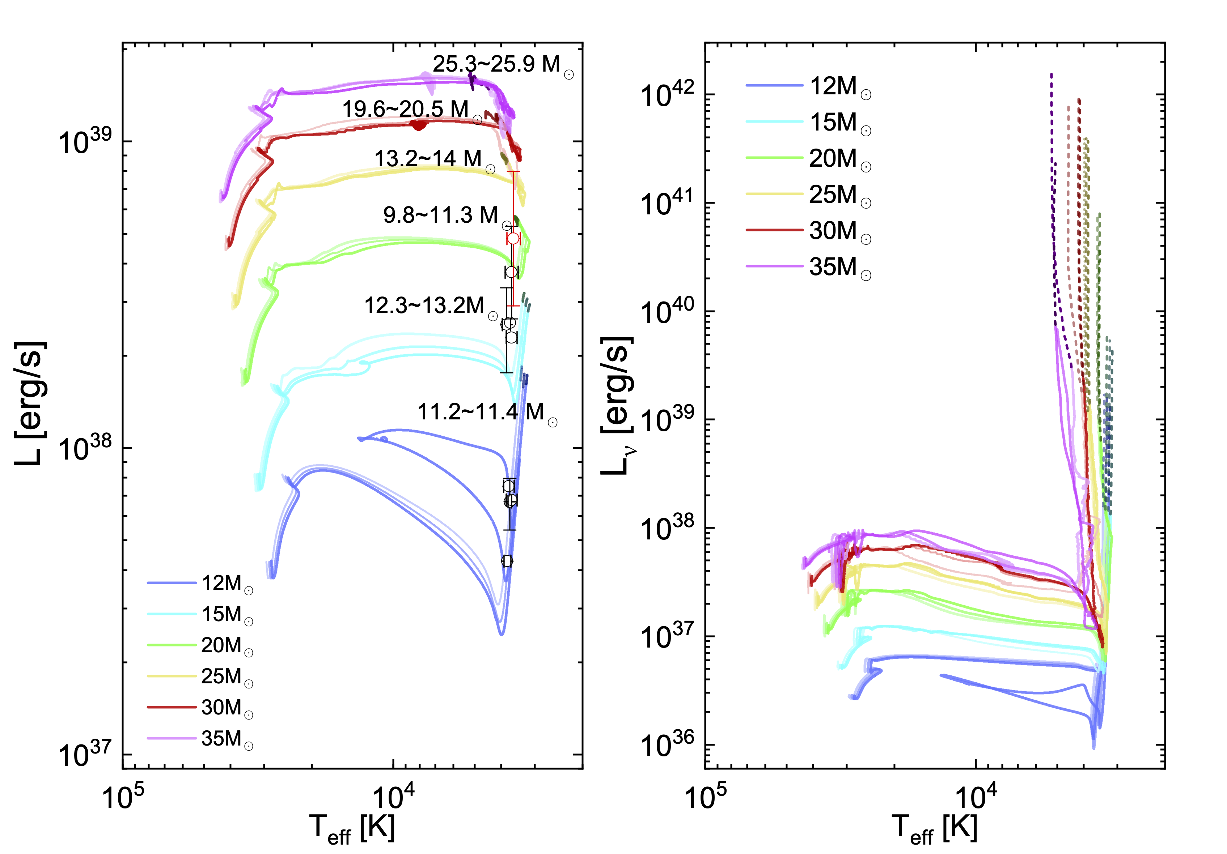
Motivation
Number of Detection Events
Number of targets
$$= f × N × σ\left(E\right) × φ(E)$$
Detection rate
Cross-section
Neutrino flux
→ 2) Monte Carlo simulations
→ 1) Stellar evolution model
NuWrO
Geant4
Recoiled Electron
(elastic scattering)
Photons
Neutrino
H₂O
물 (H₂O)
Detector
Notes:
To estimate whether such detections are feasible, we can think about a simple relation: the observed number of events on Earth depends on the flux of neutrinos arriving at earth, and because neutrino detection is based on the interaction between neutrinos and matter in the neutrino detector, cross-sections with particles inside the detector, the number of interacting particles, and the probability that such interactions are successfully detected. To compute these terms, we performed two complementary simulations. On the astrophysical side, we used the stellar evolution code MESA to simulate neutrino production in stars and to calculate the flux that would reach Earth. On the detector side, we used NuWro to simulate interactions of neutrino, in particular neutrino electron scattering in this work, and used Geant4 to simulate the propagation of the resulting photons inside the detector, thereby calculating the detection efficiency f.

Slide 5
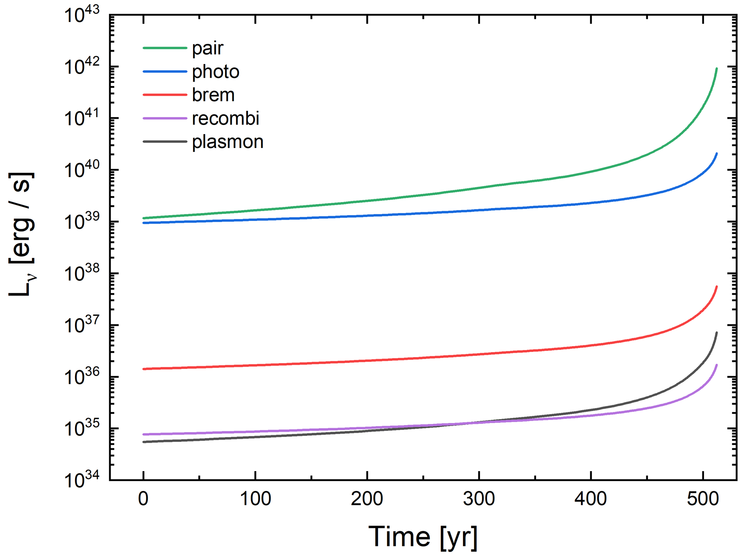
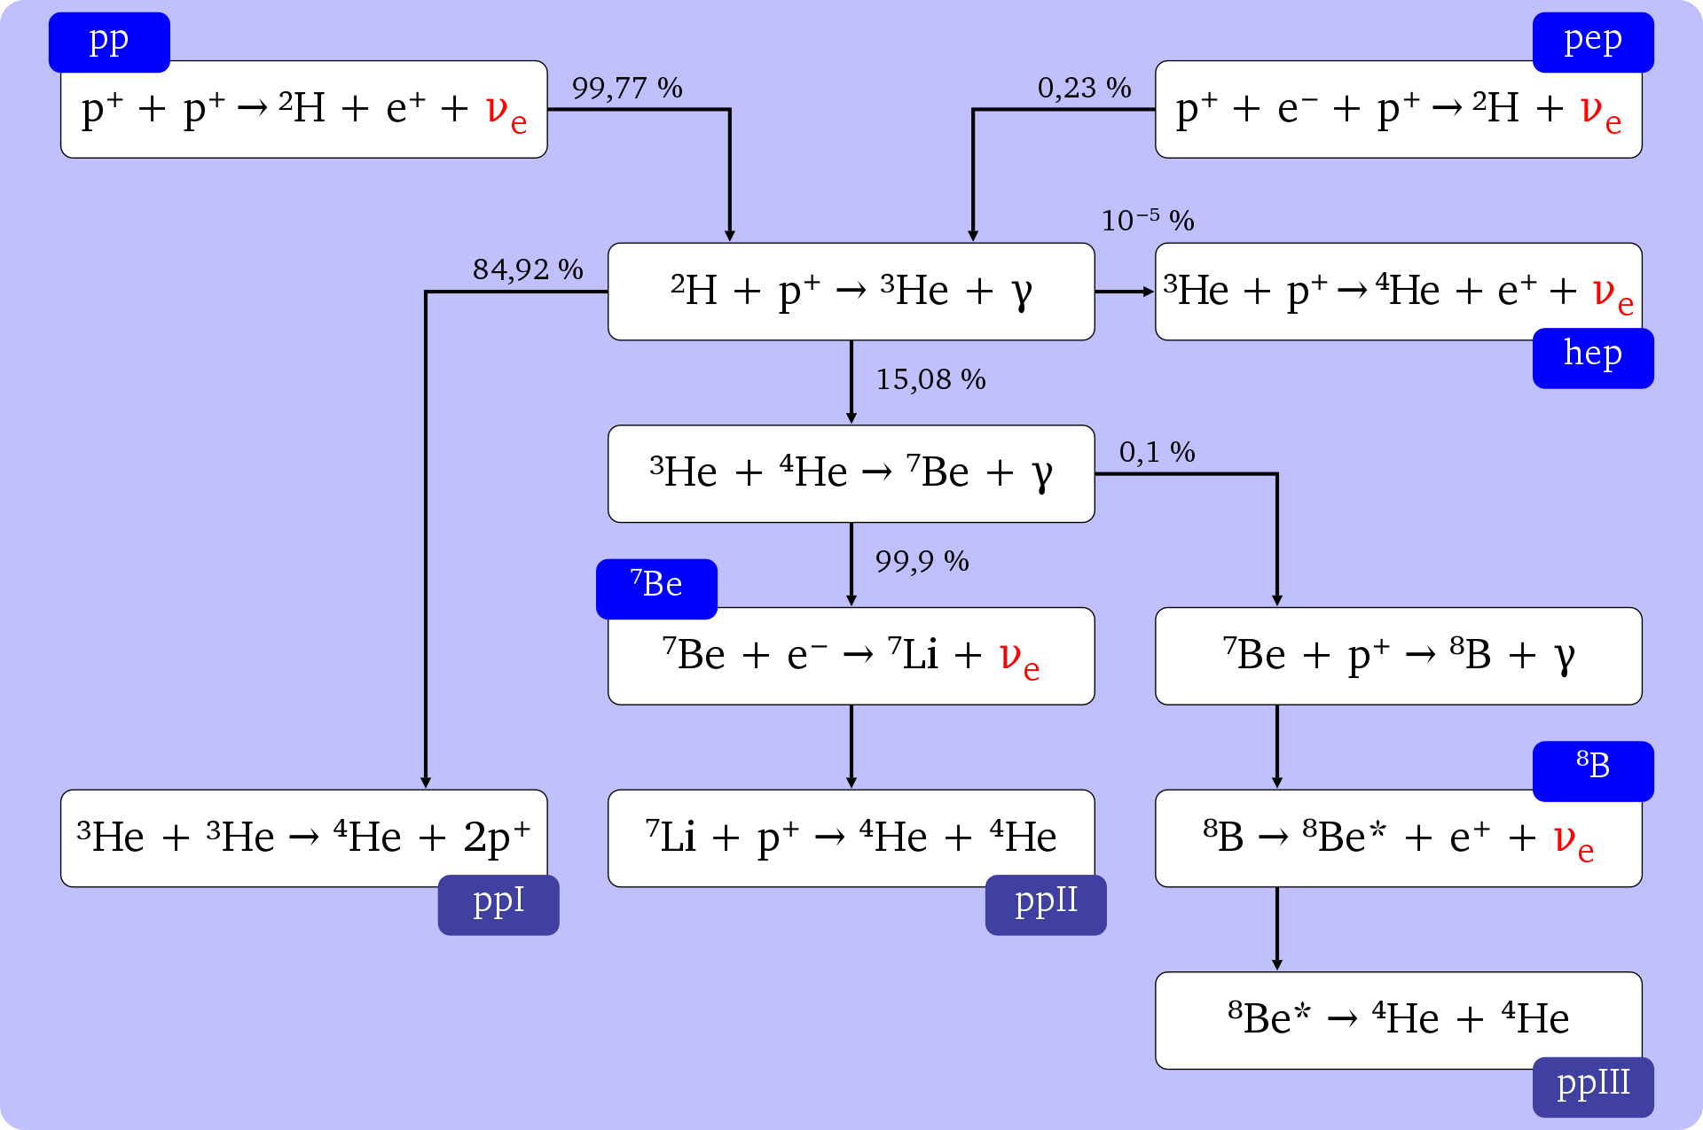







Neutrino from stars
01
Nuclear reactions (electron and positron capture, and nuclear decays)
02
Thermal processes
Plasmon decay
Photoneutrino production
Pair annihilation
Bremsstrahlung
Recombination
pp chain (solar neutrino)
Credit: Dorottya Szam
https://en.wikipedia.org/wiki/Solar_neutrino
Notes:
So, first looking at the physical process of neutrino productions from stars.
The production of stellar neutrinos occurs mainly via two processes. The first is by nuclear reactions in the stellar core. This picture shows an example of this, about solar neutrino production. This mechanism is particularly important during the early stages of stellar evolution. On the other hand, during the late stages of evolution, neutrinos are primarily produced through thermal processes.
The next figure I am showing here shows the total energy emitted by neutrino from evolved stars, during the carbon burning phase as a function of time. In this figure, we can see that the pair annihilation process is dominant than other thermal processes.

Slide 6
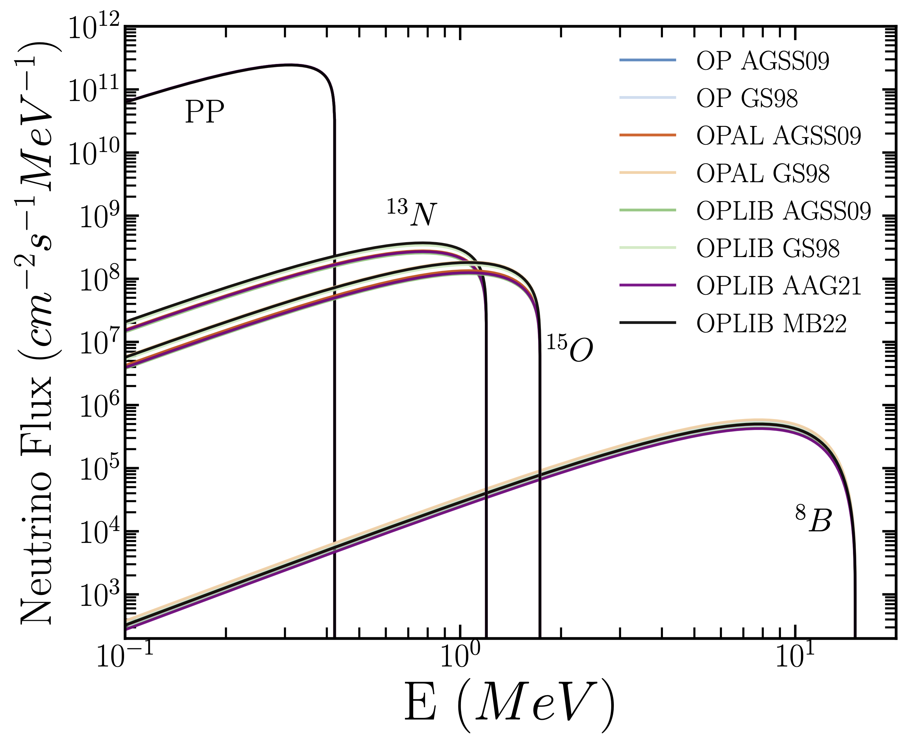
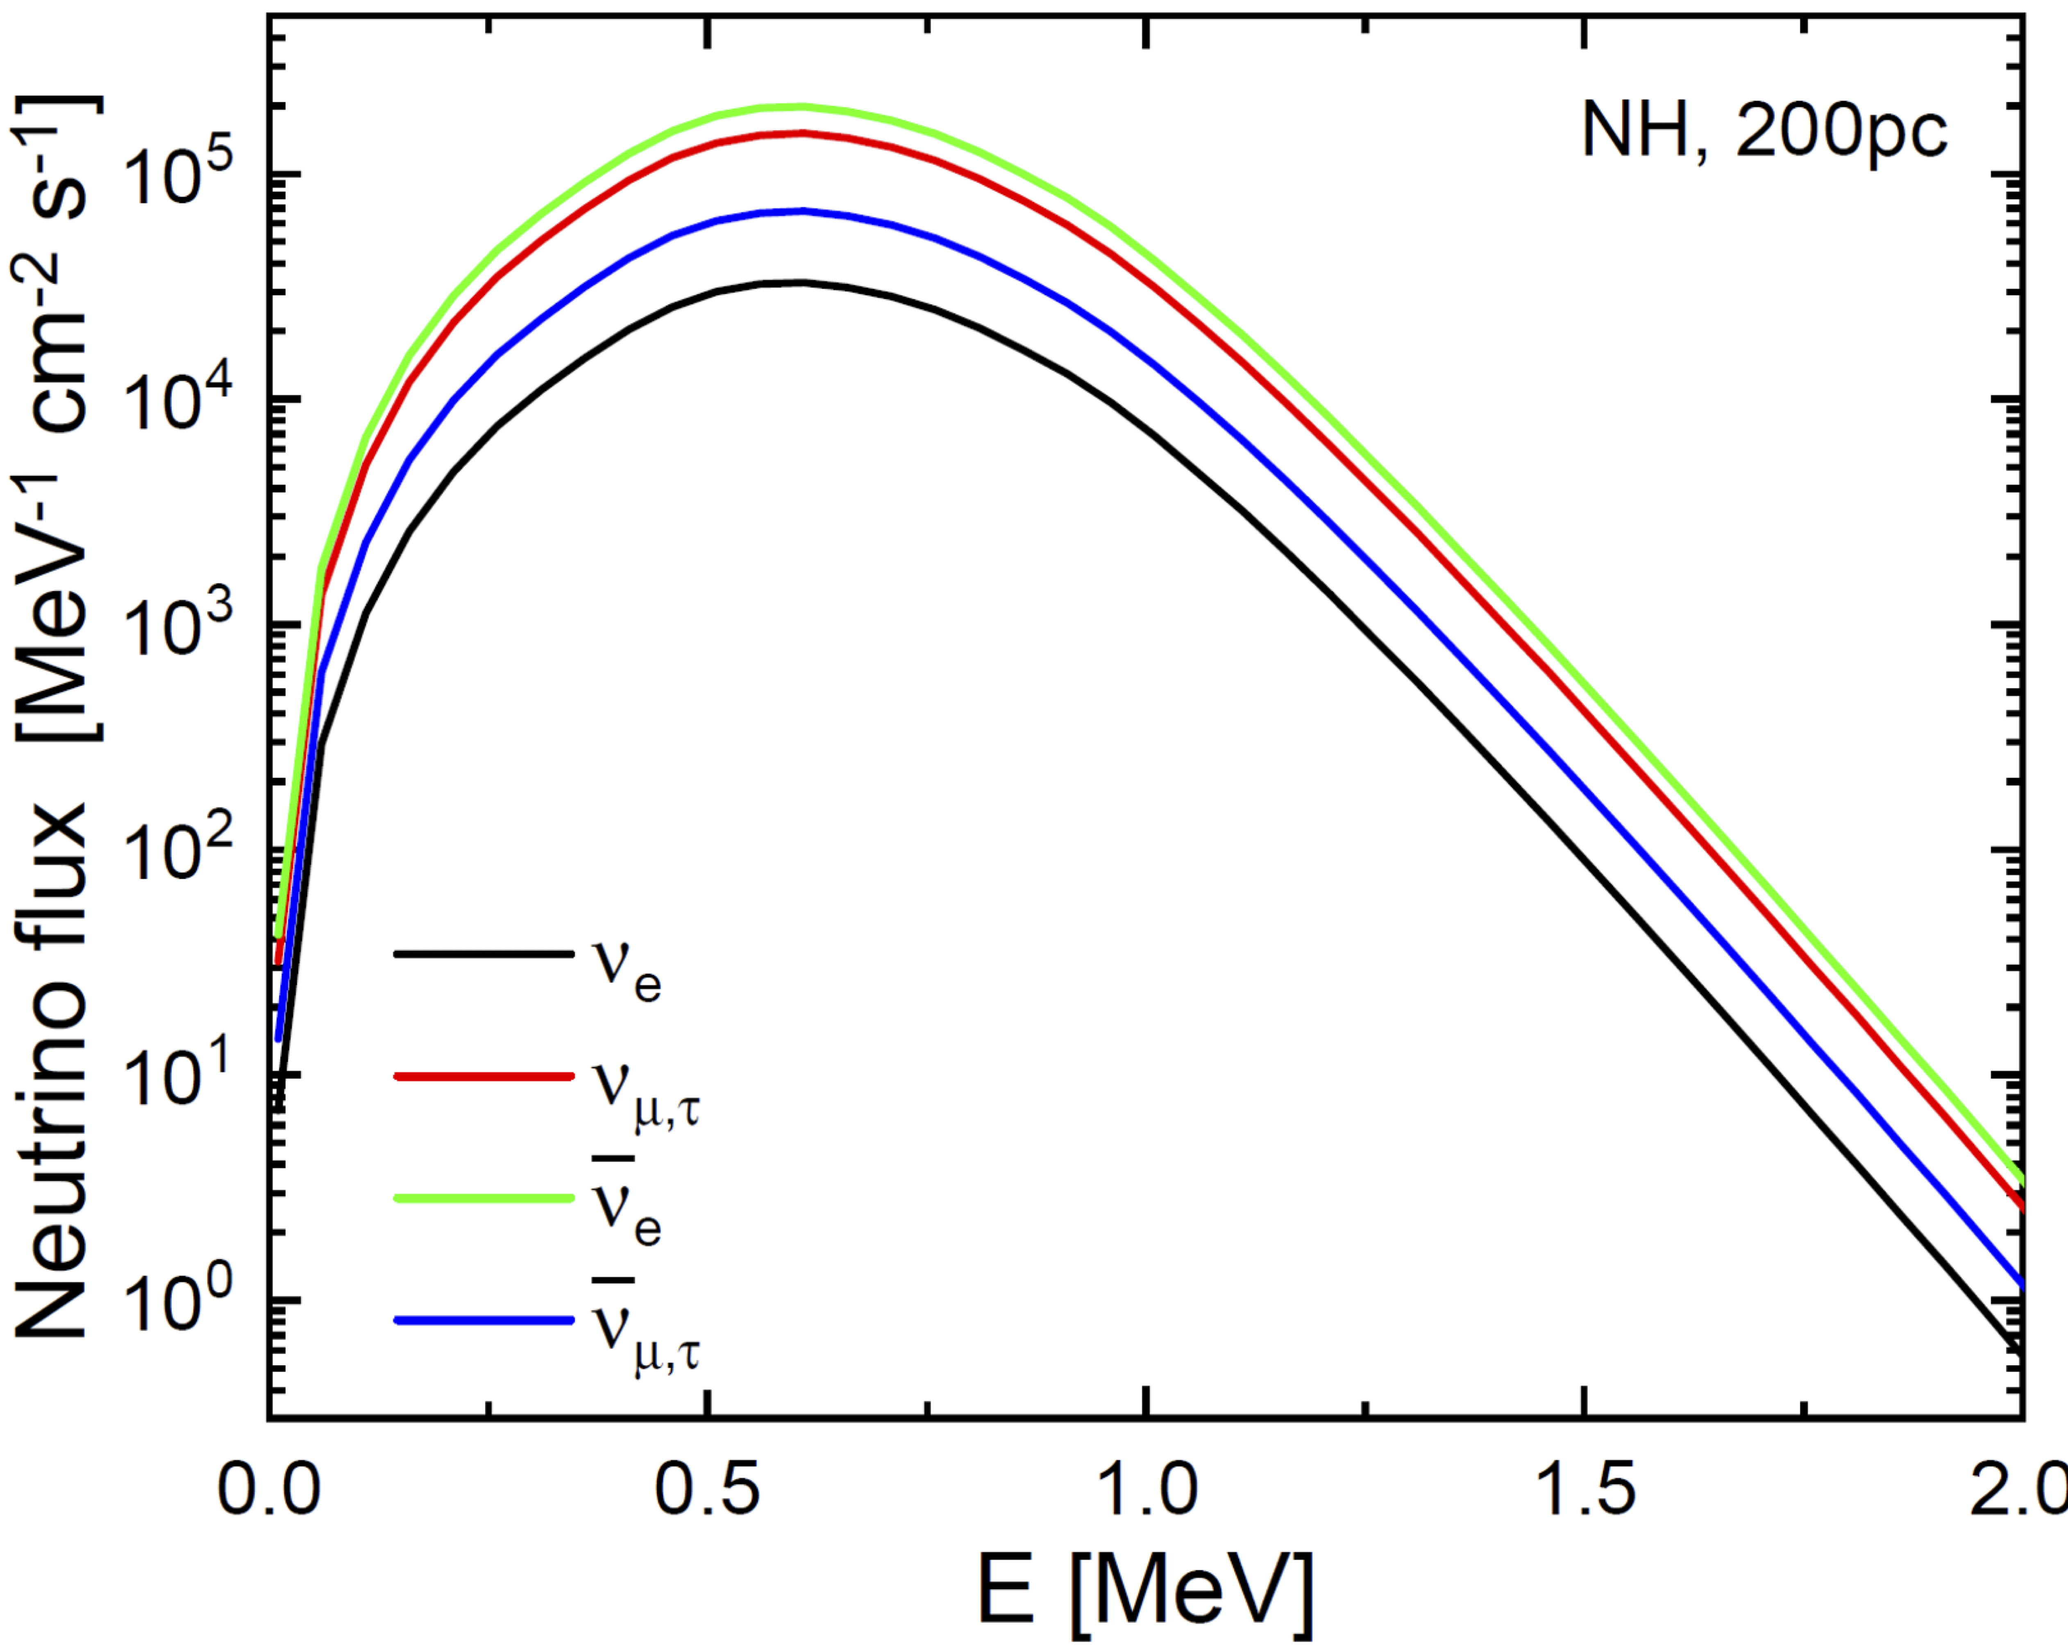
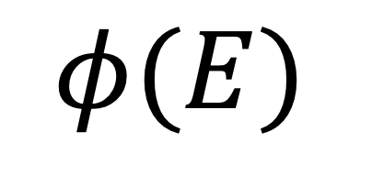
$$φ(E)$$
Neutrino flux
Solar neutrino flux
Neutrino flux from a C-burning star
Notes:
Here, I’m gonna show the results of the stellar evolution simulations, and the neutrino fluxes at Earth. The left figure shows the solar neutrino fluxes and right shows the those from carbon burning phase of evolved star as function of neutrino’s energy. If you see the neutrino energy on the x-axis here, Other than the ^8B neutrinos, the flux is concentrated at very low energies—sub-MeV. That’s basically why stellar neutrinos have been so challenging to observe. The difficulty is that conventional large water Cherenkov detectors are not efficient at detecting sub-MeV or MeV neutrinos, because sufficient recoiled energy by neutrinos is required to produce Cherenkov light. And there are many radioactive materals in water, which can make the background noise. As reference, you see this blue line, which marks the cutoff energy of Super-Kamiokande.
Other type detector, Liquid scintillator is very sensitive to low-energy neutrinos, but It’s just not big enough to show up as a detectable signal. Also they have the drawback of losing all directional information.
To overcome these limitations, we consider a new detector to detect them, this is water-based liquid scintillator (WbLS) detector.

Slide 7

Water based liquid scintillator (ex. Theia : Askin et al. 2020)
ν
Photodetector
Scintillation:
High efficiency
e⁻
Scintillation
LAB
+
Water
10%
5%
1%
Cherenkov
PMT → LAPPD
(Large Area Picosecond Photo-Detectors)
→ Time resolution ~ 100ps
Theia, Askins et al. (2020)
46 m (50 kT)
Notes:
In our study, we considered a detector with a size of 50 kilotons, corresponding in scale to Super-Kamiokande, but with a small fraction of scintillator mixed into water. This mixture improves the efficiency for low-energy neutrino detection. More importantly, In this detector, because Cherenkov photons are emitted earlier than scintillation photons, and if photodetectors have very high time resolution, one can distinguish between the two signals. This feature allows us to recover directional information for MeV neutrinos, something that purely scintillator detectors cannot provide.

Slide 8
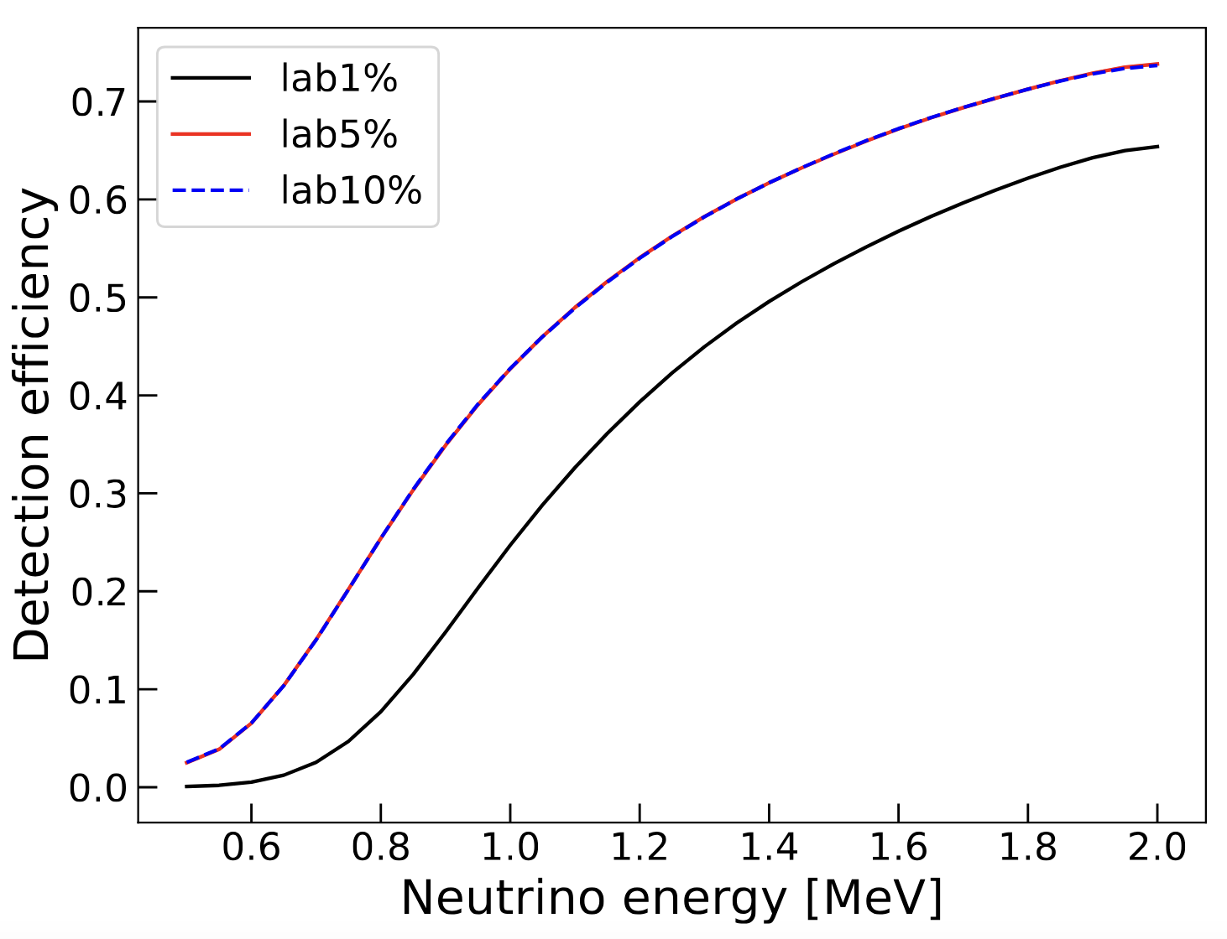
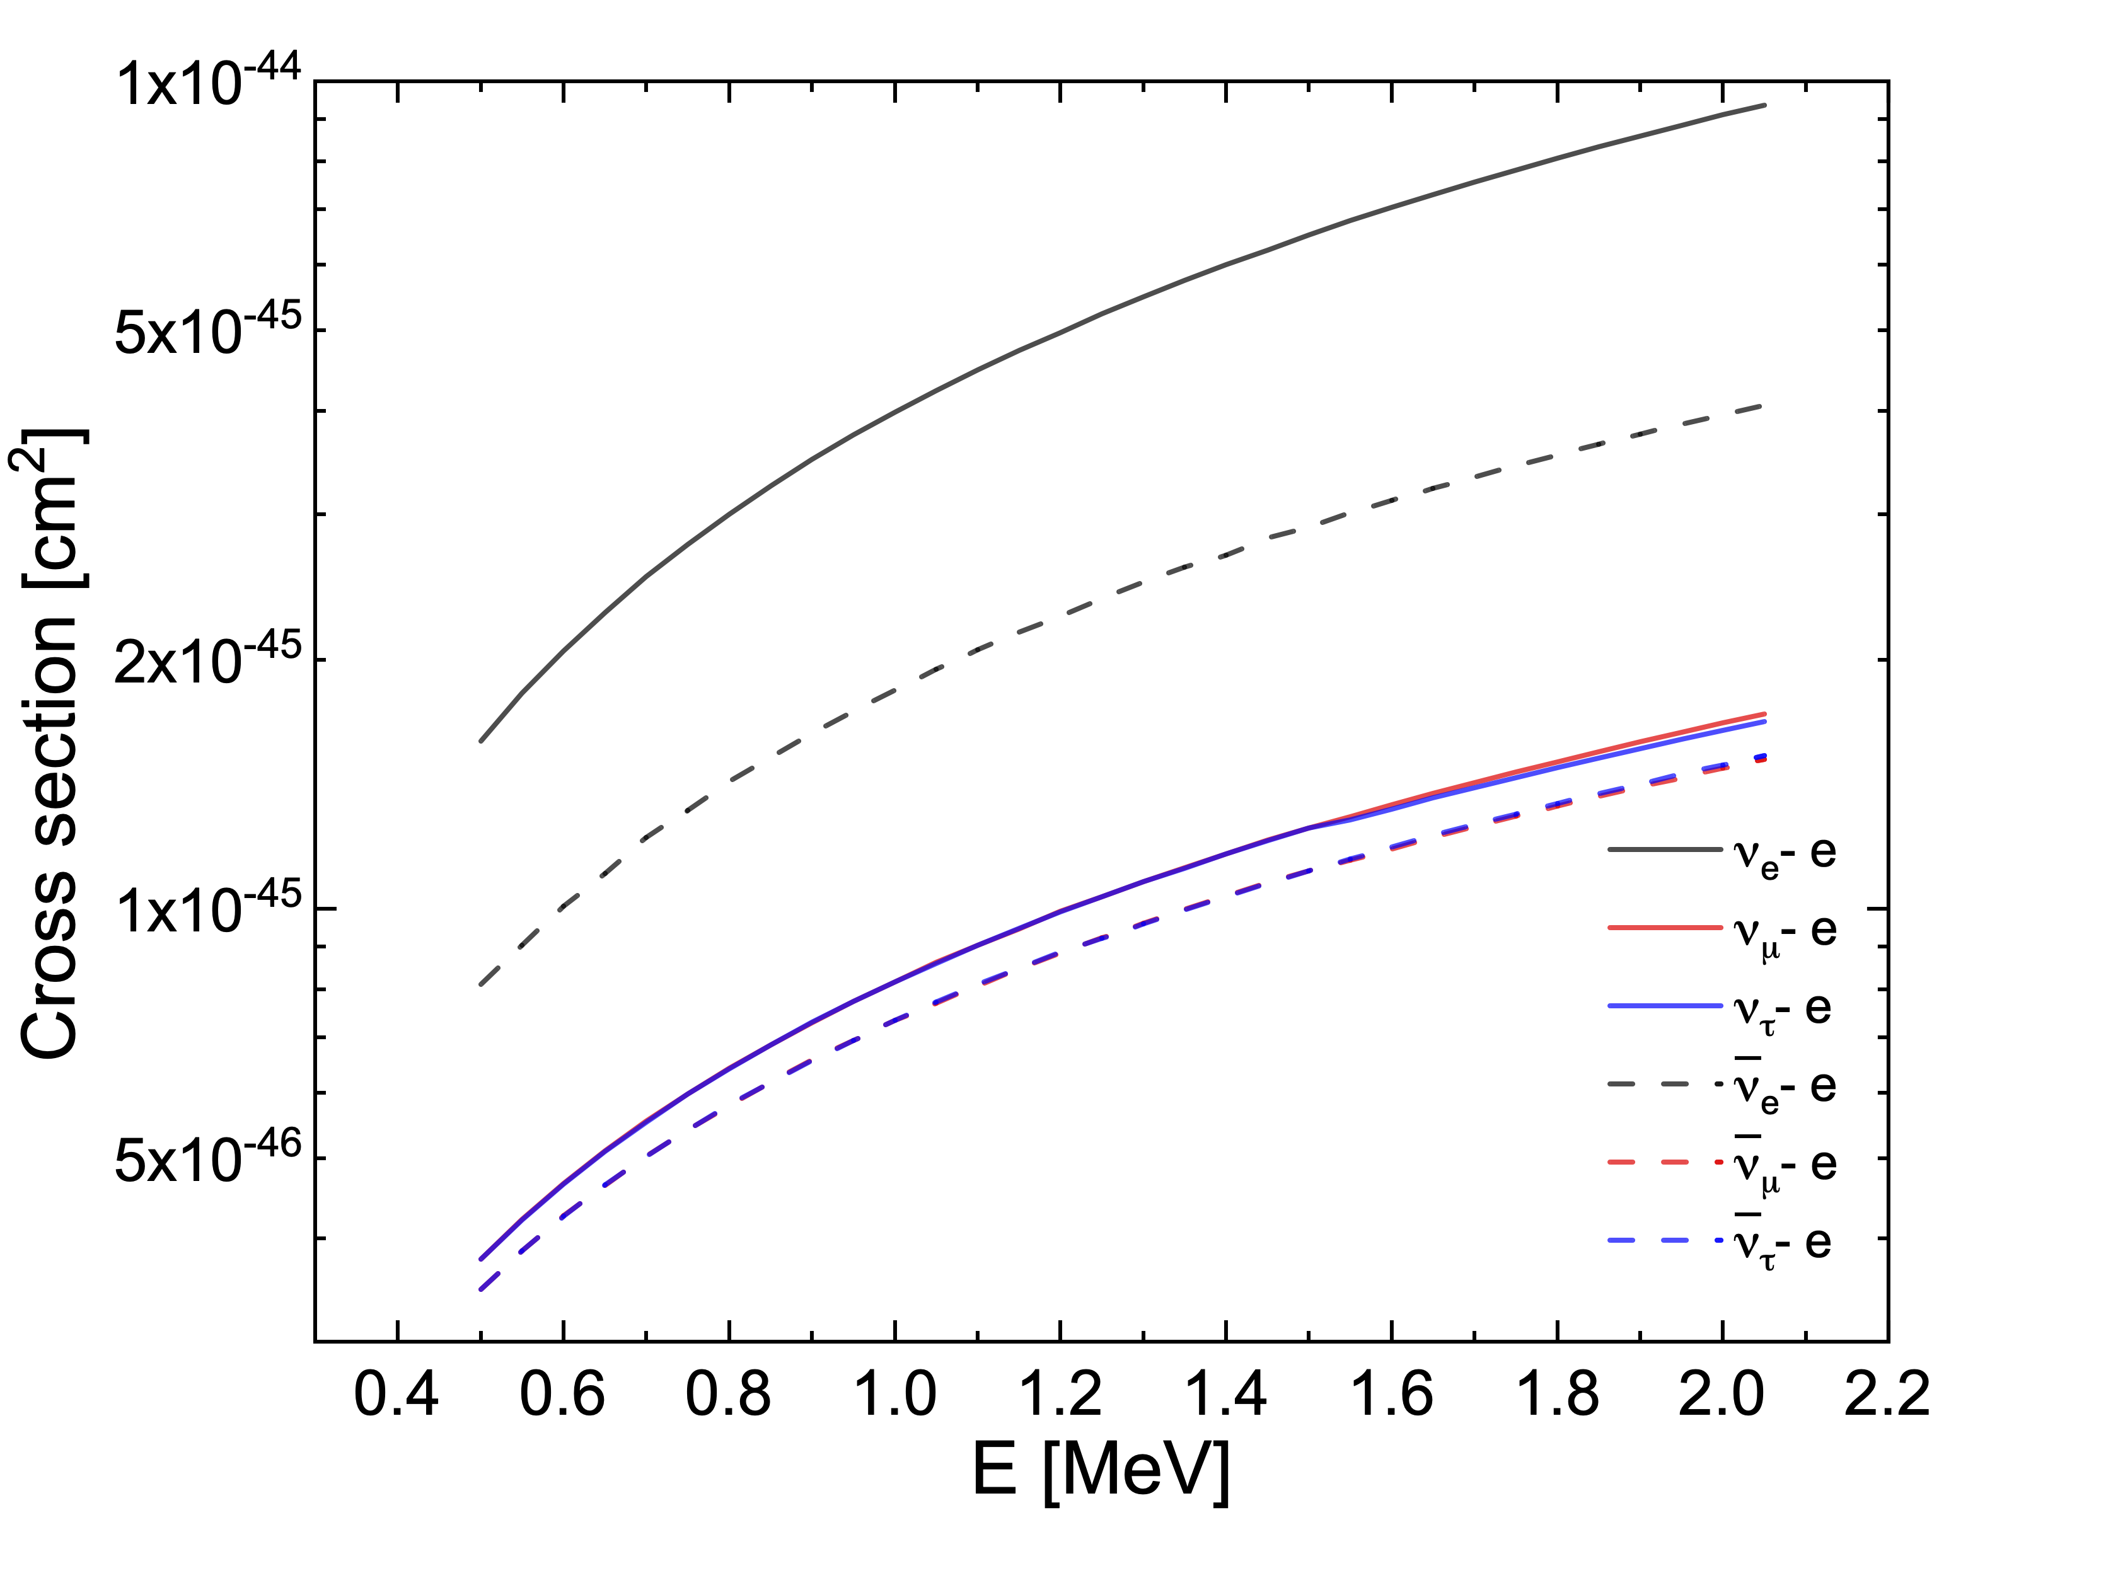

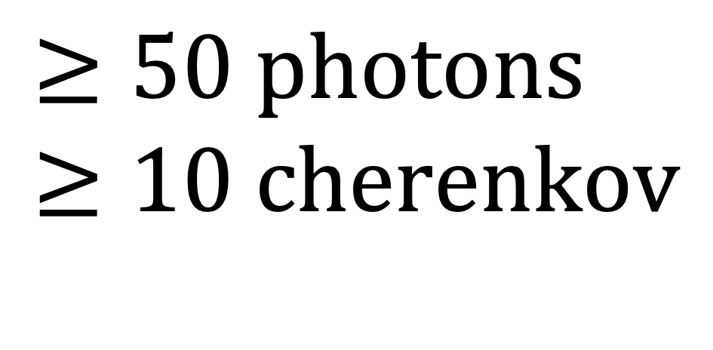
Results of Detector Simulation
$$= f × N × σ\left(E\right) × φ(E)$$
$$≥50 photons$$
$$≥10 cherenkov$$
$$Detected events / Total events$$
Notes:
Based on the Geant4 simulation of Water based liquid scintillator with configuration I mentioned earlier, we can estimate the f, and from the simulation of interaction between neutrinos and electron, we also can get the cross-section of this interaction. Here two figures show the result, as function of neutrino’s energy. As a result, from left figure, we can see neutrinos of around 1 MeV could be detected with an efficiency of roughly 3-40 percent. While this is not extremely high, it clearly demonstrates feasibility. In the right figure, we can see the dominant interaction between electron and neutrino is elastic scattering between electron and electron type neutrinos.

Slide 9
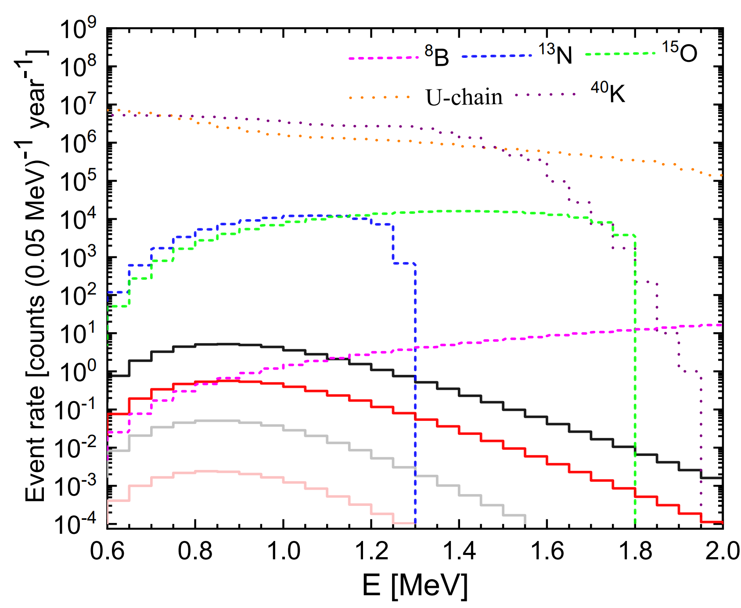
Results of Detector Simulation
10⁸
Background Noise
10⁵
CNO neutrinos
10²
Neutrinos from a C-burning star
Notes:
if there were a carbon-burning star located about 200 parsecs away, our calculations suggest that we might detect on the order of 50 neutrino events per year. In the case of solar CNO neutrinos, the number of detected events would be more than a thousand times larger, enabling a detailed comparison with solar models. Although background noise is an important consideration, these estimates suggest that new MeV neutrino sources could indeed be observed. But actually, the number of events is just too small.

Slide 10
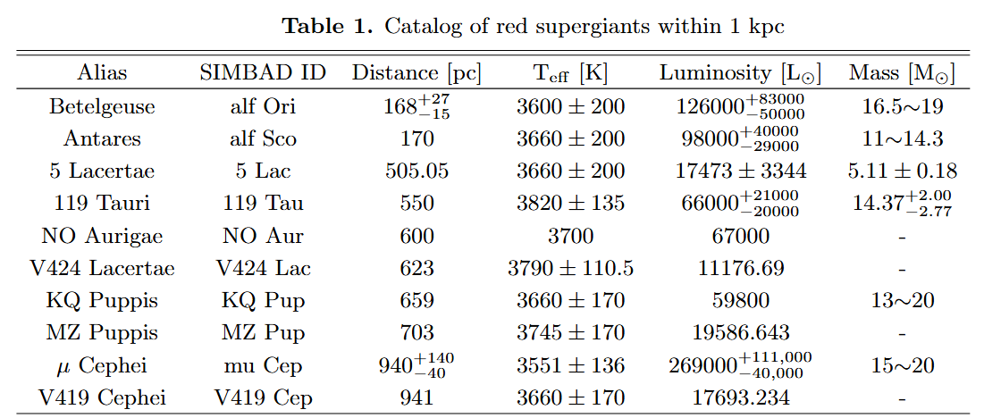
What New Science We Can Expect
For multi-messenger observations of core-collapse supernovae
Neutrinos from O-burning can provide an early warning (~ month ago) of nearby supernovae
Notes:
Altough this result is not interesting, but the scientific meassge can be quite exciting. Stars in even near depths, such as oxygen or further burning phase, emit more neutrinos at similar MeV energies. Detecting these pre-supernova neutrinos could provide an early warning of core collapse—days to weeks before the actual explosion—if such a star is located within about one kiloparsec. As a reference, here the candidates of massive stars within the 1kpc. This would be a powerful contribution to multi-messenger astronomy, allowing us to ready to observe supernova neutrinos, gravitational waves, and electromagnetic signals.

Slide 11
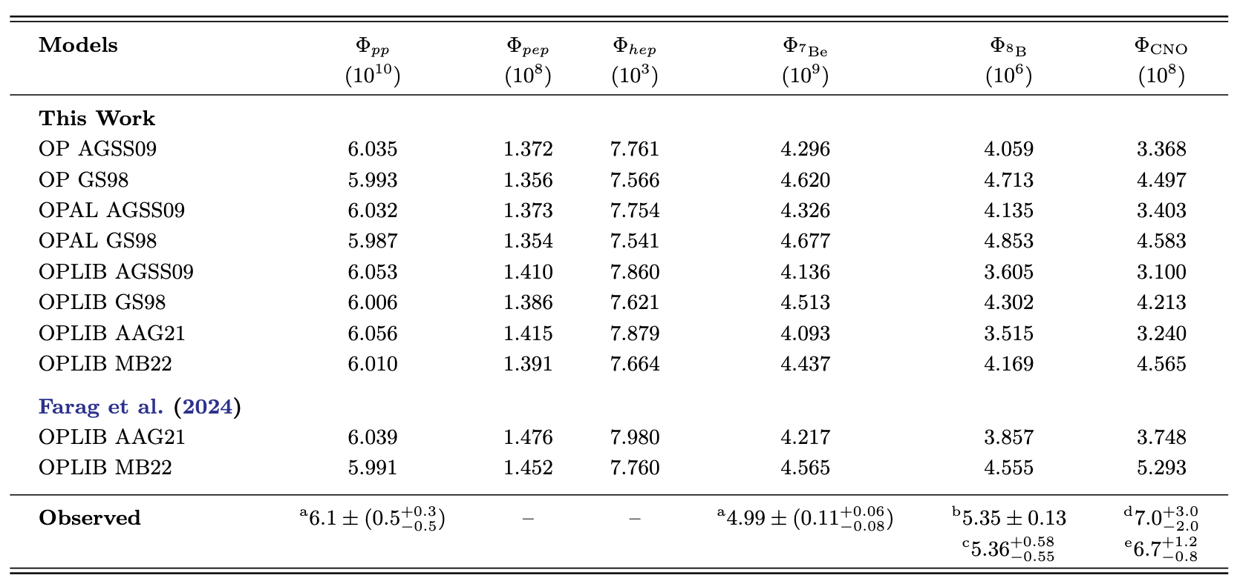
What New Science We Can Expect
Neutrinos from CNO solar neutrino → Solar modeling problem
Notes:
Moreover, the measurement of solar CNO neutrinos carries great importance for solar physics. At present, there is a discrepancy between the amount of CNO neutrinos predicted by solar models and the values measured by the Borexino experiment. A large WbLS detector, with its ability to accumulate high statistics, could play a role in resolving this solar modeling problem.
To summarize, a large water-based liquid scintillator detector has the potential to neutrino astronomy. It could allow us to observe continuous MeV neutrino sources from nearby stars, provide early-warning signals of impending supernovae, and new insight on fundamental questions about our Sun. Thank you very much.

Slide 12
THANK YOU

